Slide 1


Title I Schoolwide Programs Under the
Every Student Succeeds Act (ESSA)
What is New? What is Not?
Tina McKnight
Title I Administrative Meeting
May 18, 2016

Slide 2
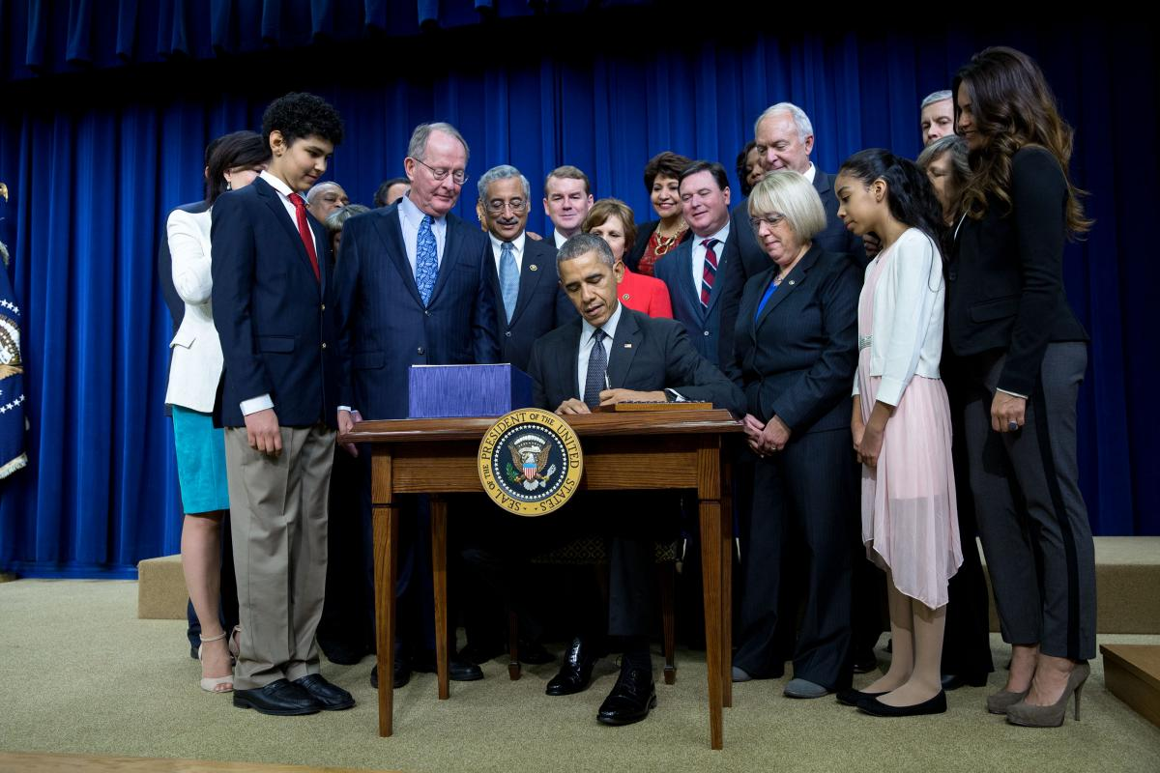
Title I Schoolwide Programs Under ESSA
Section 1114 of the
Every Student Succeeds Act
Notes:
Back a year ago we were celebrating the 50th anniversary of ESEA of 1965
Today we have the reauthorizarion of the law that many in this room never thought we would see the day. It is a new day.
Most things under schoolwide did not change. Same- Same but Differenct
Schoolwide is still Section 1114 for ESSA as it was for NCLB.
Begins on page 70

Slide 3

Title I Schoolwide Programs Under ESSA
Same Same but Different

Slide 4

Title I Schoolwide Programs Under ESSA
Implement 2017 – 2018 School Year
First year impacted by ESSA
Notes:
Full implementation is July 1, 2017.
We need to get ready now!

Slide 5

Title I Schoolwide Programs Under ESSA
Use of Funds for Schoolwide Programs (Sec.1114(a)(1))
Upgrade the entire educational program of a school with 40%
of the children from low income families
Exception: Schools with less than 40% of children from low income families MAY operate a schoolwide program if the school receives a waiver from the SEA because it can show how a schoolwide program can best serve the needs of the students.
Notes:
Blue is New or a change
How do you think a school with less than 40% poverty show that a schoolwide program can best meet the needs of the student?
There is a hint in the question----CONDUCT A COMPREHENSIVE NEEDS ASSESSMENT AND DEMONSTRATE THAT THE NEEDS ARE SUCH THAT THE ENTIRE SCHOOL NEEDS TO BE UPGRADES NOT JUST TARGETED STUDENTS
MSDE will develop

Slide 6

Title I Schoolwide Programs Under ESSA
Consolidation of Funds Sec. 1114(a)(3)(C)
A school that chooses to consolidate and use funds from different Federal programs shall not be required to maintain separate fiscal accounting records by program
School must maintain records that demonstrate the schoolwide program addresses the intent and purposes of each of the Federal programs as a whole.

Slide 7

Title I Schoolwide Programs Under ESSA
Identification of Students (Sec. 1114(a)(2)(A)(B)
All students in the schoolwide program are eligible to participate.
Funds must be used to supplement the funds that would be available from non-Federal sources (state and local) for the school.
Notes:
I wondered why the supplement language was here but it is again to emphasize the services to all students must be supplemental .
Special Education and EL c

Slide 8

Title I Schoolwide Programs Under ESSA
An eligible school shall develop a comprehensive plan that … Section 1114(b)
Is developed during a 1-year period unless the LEA determines, in consultation with the school, less time is needed to develop and implement the schoolwide program Section 1114(b)(1)
Is updated for 2017-2018 to reflect the changes in ESSA. Section 1114(b)(2)
Is regularly monitored and revised to ensures all students are provided the opportunities to meet the challenging State academic standards Section 1114(b)(2)
Notes:
This the reason will need to be sure our Title I schools understand the new ESSA law now and into 2016-2017 so that their plans for 2016-2017 will be compliant

Slide 9

Title I Schoolwide Programs Under ESSA
An eligible school shall develop a comprehensive plan that … Section 1114(b)
Is developed with the involvement of parents, teachers, principals, paraprofessionals, and other members of the community Section 1114(b)(2)
Is available to the LEA, parents, and the public in a format that is understandable and uniform and provided in the language parents can understand Section 1114(b)(4)

Slide 10
Title I Schoolwide Programs Under ESSA
An eligible school shall develop a comprehensive plan that … Section 1114(b)
Is developed in coordination and integration with other Federal, State, and local services, resources and programs such as violence prevention, nutrition, housing programs, Head Start, adult education, career and technical education programs and Comprehensive Support and Targeted Support Schools’ improvement activities.
Notes:
These are just suggested coodination activities. They must be appropriate and applicable for the school base on levels, needs, etc.

Slide 11

Title I Schoolwide Programs Under ESSA
An eligible school shall develop a comprehensive plan that … Section 1114(b)
Is based on a comprehensive needs assessment of the entire school that….
Takes into account information on the academic achievement of children on challenging State academic standards
Focuses on the needs of children who are failing,
or are at-risk of failing to meet challenging State
academic standards
Includes other factors as determined by the LEA

Slide 12
Title I Schoolwide Programs Under ESSA
An eligible school shall develop a comprehensive plan that … Section 1114(b)(7)(A)
Includes a description of the strategies that the school will be implementing to address school needs.
Describes how strategies will…
Provide opportunities for all children, in all subgroups (each major racial and ethnic subgroup, FARMs, students with disabilities, English Learners), to meet State academic standards

Slide 13
Title I Schoolwide Programs Under ESSA
An eligible school shall develop a comprehensive plan that … Section 1114(b)(7)(A)(i)(ii)
Describes how strategies will strength the academic program and increase the quantity and quality of learning time
The Schoolwide Plan may describe programs, activities, and courses necessary to provide a “well rounded education” (Providing all students access to an enriched curriculum and educational experience)

Slide 14
Title I Schoolwide Programs Under ESSA
An eligible school shall develop a comprehensive plan that … Section 1114(b)(7)(A)(iii)
Addresses the needs of all children, especially children at risk of not meeting the challenging State academic standards which may include such strategies as:
Counseling, mental health, mentoring, and other such supports
Preparation for opportunities for postsecondary education and workforce including concurrent enrollment to earn college credit
Multi-tiered systems of support to address problem behavior or early intervening
Professional development to improve instruction and the use of data
Recruitment and retention of effective teachers
Assistance with transition from early childhood programs

Slide 15

Title I Schoolwide Programs Under ESSA
Preschool Programs Section 1114(c)
A school operating a Title I schoolwide program may establish or enhance preschool programs for children under age six

Slide 16
Title I Schoolwide Programs Under ESSA
Delivery of Services
The services of a schoolwide program may be delivered by nonprofit or for-profit external providers with expertise in using evidence-based or other effective strategies to improve student achievement.

Slide 17

Title I Schoolwide Programs Under ESSA
Secondary Schools
A secondary school operating a Title I schoolwide program may use Title I funds to operate a dual or concurrent enrollment program that address the needs of low-achieving secondary school students and those at risk of not meeting State standards. Section 1114(e)
Title I funds may be used for:
  Training for teachers
  Joint professional development
  Tuition, fees and books, required instructional materials
  Transportation to and from such programs

Slide 18
Title I Schoolwide Programs Under ESSA
Under ESSA, what components will be required in the schoolwide plan?
1. Comprehensive needs assessment
2. Schoolwide strategies that:
    address the needs of all children in the school, but particularly the
    needs of those students at risk of not meeting State standards
    provide opportunities for all children to meet State standards
    strengthen the entire academic program
3. Development of the plan with parent and community involvement
4. Coordination with other Federal, State, and local services, resources,
and programs
Notes:
What is not there? Form the 10 schoolwide strategies under NCLB
Highly qualified teachers
Strategies to attract HQ teachers
Plans for transition from preschool

Slide 19
Title I Schoolwide Programs Under ESSA
Under ESSA, what components may be included in the schoolwide plan:
Social and emotional supports (Counseling, school based mental health programs, mentoring, etc.)
Schoolwide multi-tiered system of supports
Professional development to improve instruction and the use of data
Preschool programs
In secondary schools, dual and concurrent enrollment programs
Opportunities in postsecondary education and the workforce

Slide 20
Title I Schoolwide Programs Under ESSA
The Title I Schoolwide Program under ESSA is in many ways the same but it is different.
ESSA provides greater flexibility for Schoolwide Programs.
The Schoolwide Plan must be aligned to prioritized needs identified in the Needs Assessment.
Schoolwide schools can only carryout strategies expessed in their schoolwide plan.

Slide 21
Any Questions?

