Slide 1
Every Student Succeeds Act (ESSA) Update
Title I
Title I Administrative Meeting
May 18, 2016
Maria E. Lamb, Director
Program Improvement and Family Support

Slide 2
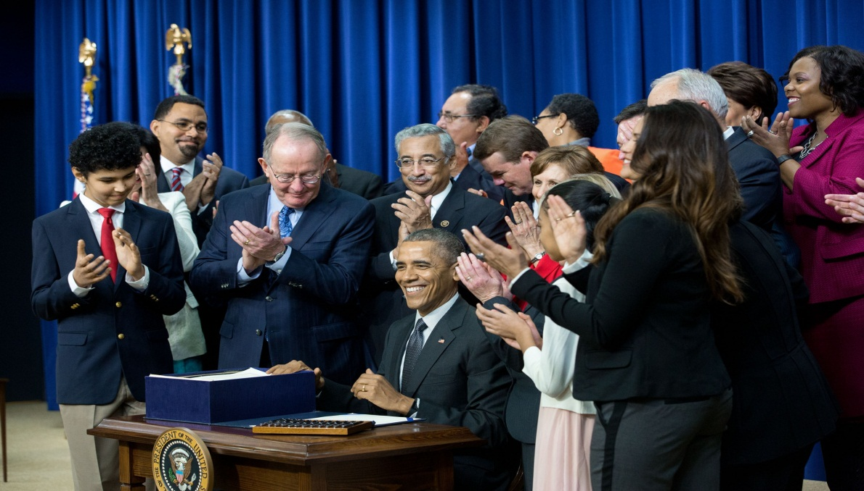
Every Student Succeeds Act
Signed into law by President Obama on December 10, 2015
Notes:
Law was signed on December 10, 2016
Various timelines provided for transition to the new law:
Non-competitive programs begin: July 1, 2016
Competitive programs: begin October 1, 2016
ESEA Flexibility: ends August 1, 2016

Slide 3
Title I: Improving the Academic Achievement of the Disadvantaged
Part A: Improving Basic Programs Operated by Local Education Agencies (LEA)
Part B: State Assessment Grants
Part C: Education of Migratory Children
Part D: Prevention and Intervention Programs for Children and Youth who are Neglected or Delinquent
Part E: Flexibility for Equitable Per-Pupil Funding
Part F: General Provisions
Notes:
Title I has several parts (A-F)
Part A is the largest portion of Title I and contains the most components and requirements
For Today’s presentation, I will focus on Part A, Part C and Part D

Slide 4
Part A: Improving Basic Programs Operated by Local Educational Agencies
  In 2016-17 the funding formula and the required reservations remain the same.
  Beginning with 2017-18 the funding increases authorized to be appropriated continue through FY 2020.
Notes:
Title I has been funded through Federal Fiscal Year 2020
FY 2017- funding increases to 15 billion
FY 2018- funding is at 15.4 billion
FY 2019- funding is at 15.8 billion
FY 2020 funding is at 16.1 billion
We serve all 24 LEAs and the SEED school of Maryland.
$ 195,892,739
$185,626,564 as pass through
95% of the 4% in School Improvement grants: $7,835,710

Slide 5
What’s New in 2016?
For SY 2016-2017 continue to implement programs under ESEA rules, with a few exceptions
  Support for Foster Care Students
  Identification of Priority and Focus Schools
  Highly Qualified Teacher requirements
Notes:
What’s new in SY 2016?
1. Title I will remain the same for SY 2016 with a few small changes:
SEAs and LEAs must provide additional support to foster care students in a manner that is similar to the protections put in place for Homeless students
Option for states to keep their current list of Priority and Focus schools or identify a new list of schools for one year
No more highly qualified teacher requirements, however teachers in Title I schools must still meet state certification and licensure requirements

Slide 6
What’s New in 2017-2018?
Each state must have a State Plan
  Stakeholder Input
  Standards and Assessments
  Performance Goals
  Accountability
  Support to Schools
Notes:
So what is new beginning in 2017?
Each state must have a state plan
Dr. Smith and Dr. Salmon will be working with the state board throughout the development process.

Slide 7
What’s New in 2017-2018?
Mandatory Set Aside
7 percent for school improvement
Optional Set Aside
3 percent for direct services
Notes:
Title I set asides will change in 2017
Set asides are required earmarked reservations:
States will reserve 7% of their allocations off the top for state administration and support to low performing schools
95% of the reservation will go to support Comprehensive Support Schools and Targeted Support Schools
A state may also reserve an additional 3% for direct services.
Direct services will be earmarked primarily for high schools for access to:
Advance courses
Career and technical education
Courses that lead to industry recognized credentials
Credit recovery and or
Academic acceleration that leads to a diploma

Slide 8
What’s New in 2017?
State identification of schools that need support and interventions
State develops exit criteria for identified schools
Notes:
We will have a new school identification system, based on the new accountability system:
We will identify Comprehensive Support Schools and Targeted Support and Improvement Schools.
These categories capture a more diverse set of schools then were captured in the Priority and Focus Schools.

Slide 9
Comprehensive Support
  5 percent of all Title I schools that are the lowest performing
  All public high schools in the state failing to graduate one third or more of their students
  Other: Any school receiving notification that a subgroup on its own would have led to identification as a comprehensive school
Notes:
Comprehensive Support and Improvement Schools may or may not be Title I schools.
This year, we have identified 26 Title I schools as Priority Schools.
We have the potential to identify many more as comprehensive schools because we will now identify any High School in the state that does not have a graduation rate greater than 67%.

Slide 10
Comprehensive Support
  State approves school improvement plans
  Evidence-based interventions approved by the State
  Public School Choice
  Improve conditions for student learning
Notes:
Comprehensive Support schools will receive a portion of the 7% reservation to implement interventions that will improve student performance.
State may distribute these funds on a competitive or non-competitive basis.
State approves their plans
State has to develop exit criteria
Local Schools Systems can include broader interventions that improve school conditions such as
Multi-tiered systems of support,
Public School Choice
awareness opportunities for post-secondary opportunities and
strategies to reduce discipline practices that are exclusionary.

Slide 11
Targeted Support
Any school served by the LEA in which any subgroup of students is consistently underperforming.
  LEA provides direct support
  LEA oversees school improvement plan
  Evidence-based interventions approved by the LEA
  Support by the LEA to address resource inequities
Notes:
Targeted Support Schools are a little harder to define until we get the regulations.
Based on our interpretation, these schools will receive most of their support through the LEA.
If subgroups fail to improve within a number of years, the school will become a comprehensive support school.
LEAs will also have the same flexibilities as the comprehensive schools to institute practices that will improve conditions for student learning.

Slide 12
What’s New in 2017?
Repeated references to enhance:
  Support for high schools and early childhood
  Meaningful family involvement
  Support for foster care students (2016)
  Program offerings through flexibility in Title I schools
  Collaboration across other Federal programs
Notes:
There are many references throughout Title I, Part A that address the need to support high schools and early learning
For example High School thresholds for automatic eligibility may be lowered from 75% to 50% if the LEAs desires.
Other areas refer to :
Meaningful family involvement in educational decision-making opportunities
Support for foster care students
Flexibility of programming which may include counseling services and Expanding services in Targeted Assistance schools to include some schoolwide activities such as professional development and implementing a Multi-tiered system of support for all students.
Collaboration across other federal programs such as Title II and Title III

Slide 13
What’s New in 2017?
Title I Application will build in more accountability
  Monitor student progress
  Identify at-risk students
  Implement evidence-based strategies
  Identify and address disparities of teacher distribution to high poverty schools
  Address the overuse of some disciplinary practices
Notes:
States will need to get assurances from the LEAs that receive Title I funds.
They will also have to describe how they will:
monitor student progress,
identify at-risk students,
implement evidence-based strategies (which are defined in the law),
address disparities of teacher distribution to high poverty schools and
address overuse of some discipline practices.

Slide 14
Part C:
Education of Migratory Children
  No substantive changes in this part.
  Continue to serve Migrant students in two summer centers on the Eastern Shore.
Notes:
No substantive changes
Maryland continues to operate 2 summer centers
Somerset County and Queen Anne’s County
Services typically in July– operate 5 days a week for extended hours.
319 migrant students K-12th grade and out of school youth.
Temporary Seasonal Work in the following industries:
Crops such as: Squash, peppers, tomatoes, watermelon
Seasonal Cannery in Queen Anne’s County,
Large Nurseries

Slide 15
Part D:
Prevention and Intervention Programs to Support Children and Youth who are Neglected or Delinquent
  Subpart I
  Education programs for students enrolled in institutions, community daycare programs, and adult corrections institutions
  Subpart 2
  LEA programs that involve collaboration with locally operated correctional facilities
Notes:
No substantive changes in either Part I or Part 2.
Part I
$1, 523,897 distributed to DLLR and Maryland Juvenile Services Education this year.
Part 2
$ 588,977 distributed to 4 LEAs: Baltimore County, Baltimore City, Montgomery County, Washington County

Slide 16

Questions

