Slide 1
Maryland State Department
of
Education
Division of Academic Reform and Innovation
Instructional Improvement Initiatives
Notes:
We want to share our work through the Breakthrough Center with you today.

Slide 2
Breakthrough Center
Maryland’s statewide system of support
to low-achieving schools
Notes:
I know you are familiar with the Breakthrough Center.
It is Maryland’s statewide system of support to low-achieving schools

Slide 3
Core Work - Instruction
Provide targeted and intensive principal leadership development
Provide targeted and intensive teacher professional development
-English Language Arts
-Mathematics
Notes:
The core work of the BTC is centered on instruction which includes two areas
Professional development for leadership development
Professional development for teachers related to English Language Arts and Mathematics – This is our focus for today

Slide 4
The Outcomes for
Professional Development
To improve teacher knowledge of both subject matter and effective instructional strategies
To build the capacity of school leadership teams to provide job-embedded professional development to increase student achievement
Notes:
Our outcomes for teacher professional development include
Read first outcome – We find that teachers with whom we work often lack the subject area knowledge to enable students to achieve the rigor and content embedded in the State Curriculum. They also lack the knowledge of strategies to engage students in rigorous instruction.
Read second outcome - Research indicates that effective PD is not an event – Effective PD is job embedded

Slide 5
MSDE Staffing
Maryland’s RTTT Scope of Work provides 10.5 positions for the teacher professional development initiative
Notes:
In our RTTT grant, funds were provided to hire 10.5 position shared between reading and math to provide teacher PD in these schools
The hiring process for the Education Program Specialists began in October 2010 and continued through the summer of 2011 – We
interviewed a lot of people because we wanted to select the strongest people
We selected candidates who demonstrated strong content knowledge and knowledge of current/effective instructional practices as
well as outstanding human relation skills. In addition, all candidates had mentoring or coaching experience.
Once we hired the Education Program Specialists, we provided extensive in-house and in-the-field training to ensure they
consistently implemented our researched based professional development model with fidelity.
We provide ongoing support for these Education Program Specialists and monitor their work to ensure high quality work.

Slide 6
Which schools do we support?
School Improvement Grant (SIG) schools and identified feeder schools
Notes:
Maryland’s RTTT Scope of Work also defines which schools can be supported in ELA and mathematics – These are schools funded
by Title 1/SIG grants and identified feeder schools. Therefore, our schools are either in BCPSS or PGCPS
We first met with the district leadership staff in each district and both districts scheduled a meeting with principals of the feeder and the SIG schools and asked us to explain our professional development initiative , which we did. They invited them to participate in our program
Based on the requests received from the district leadership and principals to participate in our initiative, two zones of participating schools
have been formed
The Baltimore City zone includes 2 high schools and 3 elementary schools. Some schools chose other programs offered through the Breakthrough Center to meet their needs such as student support services. We are continuing to add schools to this zone. Baltimore City leadership staff is selecting schools we would add.
The PGCPS zone includes 4 middle schools and 8 elementary schools.
(See handout for names and locations of schools)

Slide 7
Needs Assessment
Meeting with school leadership
Action Plan
Development of a customized professional development plan
PD Calendar
Schedule of professional development activities
Notes:
When a school requested our service, we met with principal and leadership team to define the work of our partnership – We
emphasized that our partnership is not evaluative and that it is not about compliance. We want to support the schools
We developed a PD plan in partnership with the principal and ILT that was customized to meet the instructional needs in ELA and/or math (some schools wanted just one subject area and most wanted both area.) -
First, we determined the instructional strengths and needs of teachers were determined
Then we selected the participants - We included classroom teachers, special education teachers, ELL teachers, and coaches
Determined the outcomes for school based on needs
Created activities to achieve the outcomes – Joy will share examples with you shortly.
Finally, we identified the means to assess the effectiveness of the plan in order to make ongoing adjustments
The PD calendar was developed that includes the specific dates and types of activities – cite number of visits
The Education Program Specialists spend 3-5 days in a school depending on the needs and the number of teachers with whom they
are working. They each have several schools.

Slide 8
Model of Professional Development
Collaborative Planning and Lesson Design
Lesson Implementation
Lesson Debriefing/Analysis of Student Work
Differentiated Professional Development
Notes:
Joy Donlin, one of our mathematics Education Program Specialists will describe the PD model we use in schools
There is a description in your packet – Joy will go into detail
4 Distinct phases to the job-imbedded professional development. Throughout each phase, direct support to individual regular. Special education and ELL teachers, teams of teachers, content leadership and administrative leadership is provided.

Slide 9
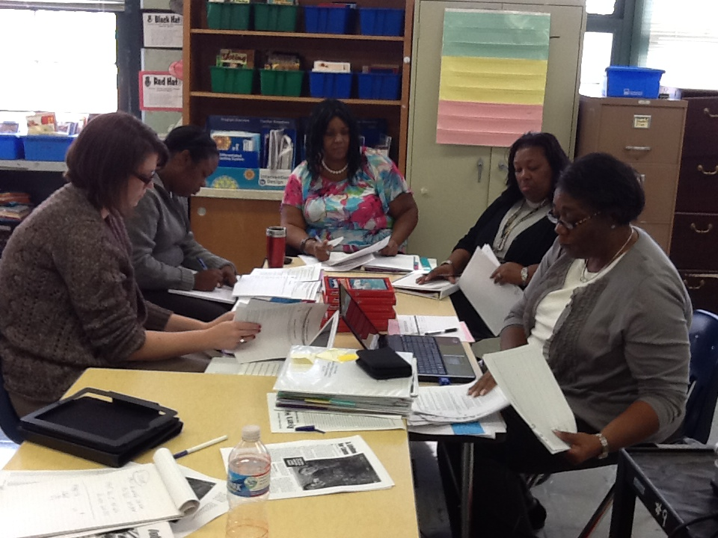
Collaborative Planning
Notes:
Collaborative planning is the first phase of the job-imbedded professional development. A content objective from the state curriculum is identified by the school-based teachers prior to the planning session. As the program specialist assigned to the school, I facilitate collaborative lesson planning focused on the identified content objective. A backward design process is used.
- unpack and scaffold the content objective – provides a vehicle for building content knowledge of teachers
- write the lesson outcome – learning target
- determine the formative assessment that will be used gather a demonstration of the intended learning by individual students
- lesson design focused on building understanding prior to the use of a procedure or set of steps using manipulatives/representations/models, multiple opportunities for all students to process their learning, appropriate practice and checks for understanding
- explain and practice each of the lesson components – builds teacher capacity to effectively implement the lesson
Participants in this phase include regular education, special education and ELL teachers, content leaders and members of the administrative leadership team.

Slide 10
Model of Professional Development
Collaborative Planning
Lesson Implementation
Notes:
Second Phase of the Professional Development cycle is Lesson Implementation.

Slide 11
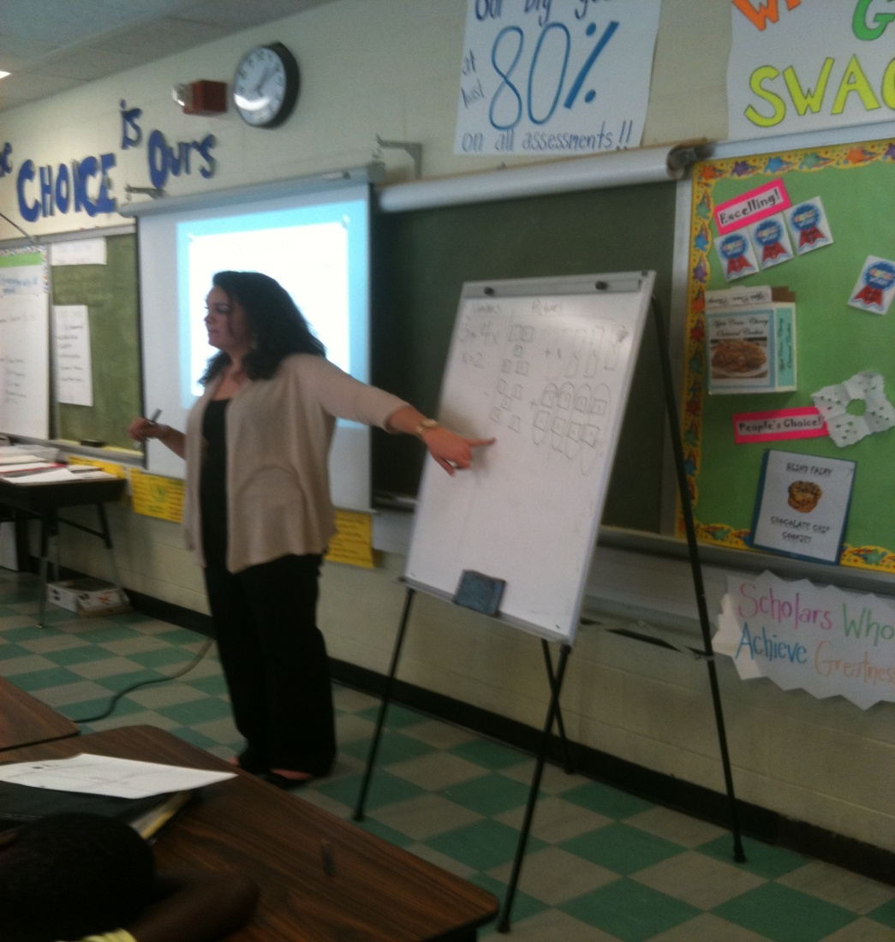
Lesson Implementation
Notes:
The lesson implementation is the non-evaluative observation of the lesson designed in collaborative planning. Some portion of the planned lesson is observed by all members of the implementation team for all teachers who participated in collaborative planning. Other participants in this phase include members of the content and administrative leadership team who attended the collaborative planning.

Slide 12
Model of Professional Development
Collaborative Planning
Lesson Implementation
Lesson Debriefing/Analysis of Student Work
Notes:
The third phase of the professional development cycle is Lesson Debriefing and Analysis of Student Work. This occurs immediately following the lesson implementation phase in order to provide immediate and effective feedback to teachers. The effectiveness of the lesson is determined thru the lens of individual student work that is collected in response to the common formative lesson assessment developed in collaborative planning. Participants include observed teachers and members of the observation team.

Slide 13
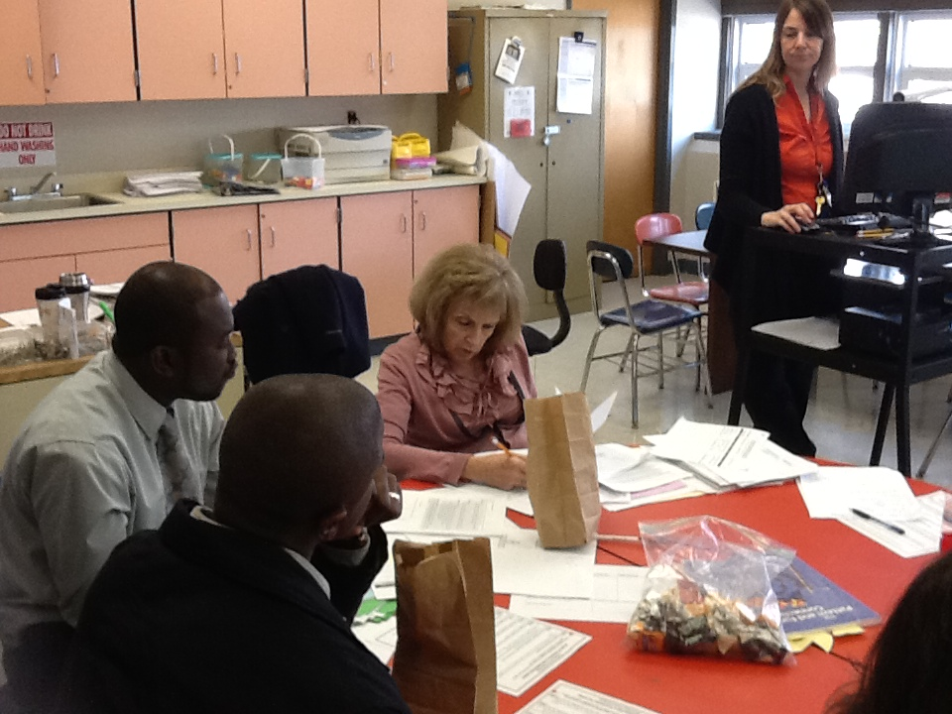
Lesson Debriefing/Analysis of Student Work
Notes:
All teachers who implemented the lesson bring the individual student work samples of the common formative assessment collected. Teachers select student work samples for sharing that provide evidence of student learning. Student work samples showing evidence of complete understanding, evidence of partial understanding or evidence of little or no understanding are shared. Only after examining student work samples are lesson components reviewed and evaluated for contribution to or interference with student learning. This reflection on lesson effectiveness thru the lens of individual student learning evidence is powerful. It emphasizes the description and analysis of instructional practice thru its truest test – whether or not students are learning.
In the final portion of this phase individual teachers are asked to identify a personal planning or implementation goal for the increased effectiveness of their teaching. This individual goal is shared publicly and used to determine appropriate support needed to achieve that goal.

Slide 14
Model of Professional Development
Collaborative Planning
Lesson Implementation
Lesson Debriefing/Analysis of Student Work
Differentiated Professional Development
Notes:
The final phase of the professional development cycle provided to schools is differentiated professional development. This is a strategic and purposeful response to the individual teacher goals identified at the lesson debriefing.

Slide 15
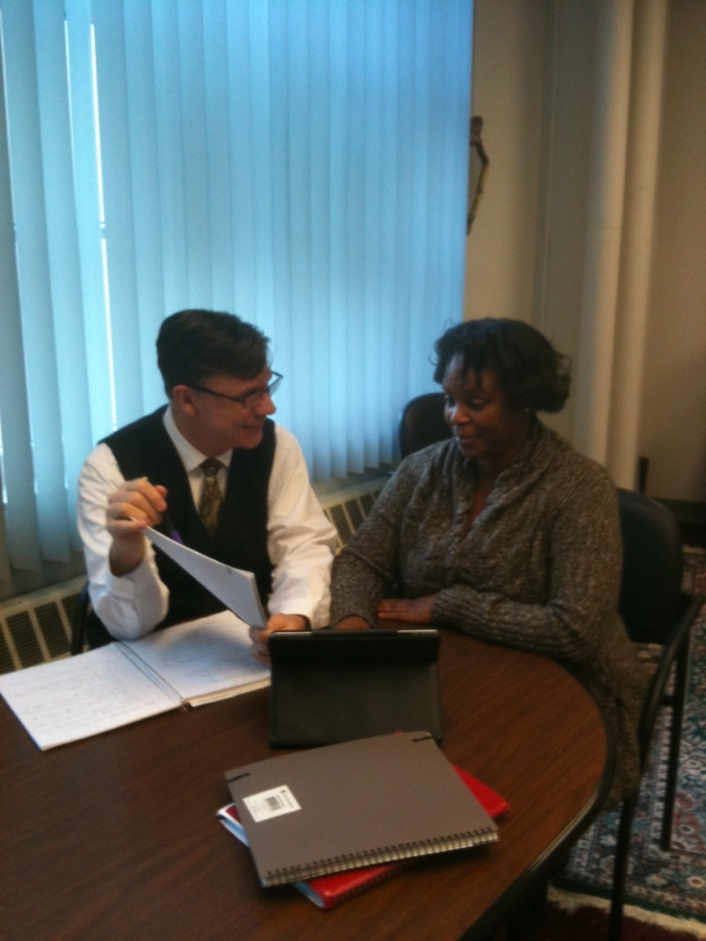
Differentiated Professional Development
Notes:
The specific activities for differentiated professional development are planned in collaboration with the content and administrative leadership team at the school. Some examples might be: focused peer observation, shared teaching of a lesson, think aloud lesson planning for a model lesson, data analysis, long-range planning. The plan includes the specific role of the Maryland State Department of Education program specialist on the identified date as well as the role of the school-based leadership either prior to or as follow-up to the specific activities. This phase is an essential component of the professional development cycles as it supports individual teachers in increasing the effectiveness of their instructional practice. This phase supports the long-term sustainability of the professional development insuring that it has a direct impact on classroom practice.

Slide 16
Partner Perspective
Judi Strawbridge
Francis Scott Key Elementary School

Slide 17
Lasting improvements in teaching and learning can only come from a strategy focused on improving instruction
Richard Elmore, 1996

