Slide 1

Support for the Change, Challenge, and Commitment
All Maryland Students
College and Career Ready

Slide 2

Funding for the Change,
Challenge and Commitment
Race to the Top
Title I School Improvement Grant

Slide 3
Four Assurances for Reform
Implementing College
and
Career-Ready Standards
Great Teachers
and
Leaders
Providing information to families and educators through improved data management systems
Improving student learning and achievement in our lowest performing schools

Slide 4
Overarching Themes for Reform
• Raise the bar and close the gap for all
students.
• Tight on goals. Loose on means.
• Foster innovation and reward success.
• Support students graduating ready for
college and a career.
• Build on the four assurances.

Slide 5

Overview of Title I 1003(g)
School Improvement Grant (SIG)
Maryland’s SIG Award $47,247,771
Timeline- School Year 2010-2013
Purpose- Support for Maryland’s lowest performing schools
Maryland’s definition for Tier I, Tier II, and Tier III Schools
Four Required Intervention Models
Maryland’s approved application posted on the ed.gov website
Notes:
Shortly before noon on March 25 Dr. Grasmick was informed of the final approve of the Maryland Title I 1003 (g) School Improvement Grant (SIG). The award to the state is $47, 247, 771. The work on writing the SEA and the LEA application for the SIG grant was done by Mari, Jim, Carol, and I. There many long days in Jan and Feb at MSDE and at home as we wrote and still had to fulfill our other Title I responsibilities, like our annual Title I Program Reviews.
Maryland’s large SIG grant award is indicative of the massive infusion of federal funds through the American Recovery and Reinvestment Act of 2009. A little over $40 million of the SIG grant were from ARRA as Dr. G pointed out in her presentation this morning. The rest is regular Title I part A which is annually awarded to SEA for low achieving Title I schools.

Slide 6
Maryland’s Tier I, Tier II and Tier III Schools
Tier I
The state’s 5% persistently
lowest-achieving Title I schools in
improvement, corrective action,
or restructuring or the state’s
bottom 5 lowest achieving Title I
schools, whichever is greater.
Tier II
The state’s persistently lowest-achieving Title I eligible (but not participating) secondary schools with equivalently poor performance as Title I schools. If a state chooses, certain additional Title I eligible secondary schools with a graduation rate below 60% over a number of years.
Tier III
Any state Title I schools in improvement, corrective action or restructuring that are not identified as persistently lowest-achieving in Tier I. These schools are served only after sufficient funding for all Tier I and II school has been met and there is still a surplus of SIG funds.

Slide 7
1. Replace principal and at least 50% of the staff.
2. Adopt new governance.
3. Implement a new or revised instructional program. 4. Recruitment, placement, and development of staff. 5. Schedules that increase learning time for both
students and staff.
6. Provide appropriate social-emotional and
community-oriented services/supports.
Close the school and restart it under the management of a charter school operator, a charter management organization (CMO), or education management organization (EMO).
A restart school must admit, within the grades it serves, any former student who wishes to attend.
Closing the school and enrolling the students who attended the school in other, higher-performing schools in the LEA.
1. Develop and increase teacher and leader effectiveness,
includes replacing the principal.
2. Implement comprehensive instructional reform programs
using student achievement data.
3. Increase learning time and create community-oriented
schools.
4. Provide operating flexibility and intensive support.
(includes 11 required strategies, 15 permissible strategies)
Schools receiving SIG funds must select one of the four intervention models:
Turnaround Model
Restart Model
Closure Model
Transformation Model

Slide 8
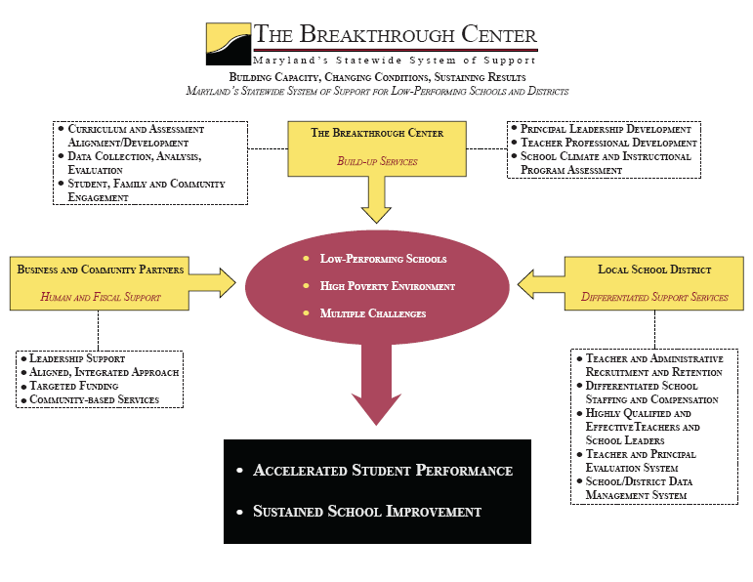

Slide 9
Race to the Top
Title I School Improvement Grant
Lowest achieving schools
Definition of Tier I, II and III schools
Breakthrough Center support
Title I Schools
Title I Eligible Schools
Grants to LEA s with MOU agreements
4 Intervention Models
Frequent Monitoring and Accountability
Competitive Grants
Glimpse of Reauthorization
(Reform for all schools)
Up to $250M possible for Maryland
Broad Focus
4 Assurances
3. Extends statewide support through Breakthrough Center
4. SEA and LEA reforms
5. Timeline (fall 2010-2014)
1. $47M (ARRA +
Title I, Part A)
2. Focus on the state’s persistently lowest achieving schools
3. Supplement Not Supplant applies
4. LEA and school reforms
5. Timeline (SY 2010-2013)

Slide 10

Future of Reform for All Maryland Schools
Change, Challenge, Commitment
Race to the Top
and
School Improvement Grant

Slide 11

By 2020, America will once again have the highest proportion of college graduates in the world.”
President Barack Obama,
February 24, 2009

