Slide 1





Alternative Governance Proposals
Deep Creek Magnet Middle School
Dundalk Middle School
Windsor Mill Middle School
White Oak School
Presentation to the
Maryland State Board of Education
May 22, 2012

Slide 2

Baltimore County Public Schools
Blueprint for Progress
High expectations through high standards
Focus on college and workforce readiness
“All Means All”
Consistent focus yields results….

Slide 3
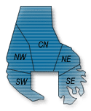
Baltimore County Public Schools:
District Profile
26th largest school district in the nation
3rd largest school district in Maryland
173 schools, centers, and programs
    106* elementary schools
    27 middle schools
    24 high schools
    4 special education schools
    10 centers
    2 programs
105,315 students (as of September 30, 2011)
17,000 employees including 8,850 teachers

Slide 4
Baltimore County Public Schools:
District Profile
Sustained, continuous improvement
Elimination of low-level courses
Expanded AP course offerings
Partnerships with higher education
Cultural and other exchange programs
Technology infrastructure
College Board partnership
AVID
College Gateway and Diploma to Degree programs

Slide 5

Baltimore County Public Schools:
Alternative Governance
Since 2006-
Alternative Governance Option I
  Replace all or most of the staff, which may include the principal, who are responsible for the school not meeting AYP.
Strengthen Instructional Programs
  Professional development, alignment of efforts, monitoring data and analysis, instructional adjustments.
Focused Planning
  Collaboration with stakeholders.
Notes:
5

Slide 6
Alternative Governance/
Restructuring Results
Three schools exited school improvement after implementing alternative governance plans –
Woodlawn Middle School
Woodlawn High School
Dundalk High School
Notes:
6

Slide 7

School Profiles:
Restructuring Planning for 2012-2013
Deep Creek Magnet Middle School (DCMMS)
  Southeast Area
Dundalk Middle School (DMS)
  Southeast Area
Windsor Mill Middle School (WMMS)
  Southwest Area
White Oak School (WOS)
  Central Area
Notes:
7

Slide 8
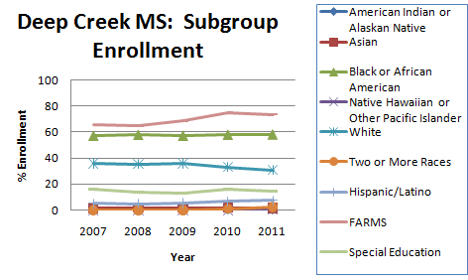
School Profile:
Deep Creek Magnet Middle
2010-2011
Enrollment: 791
Mobility Rate : 34.2%
FARMS Rate: 74.0%

Slide 9
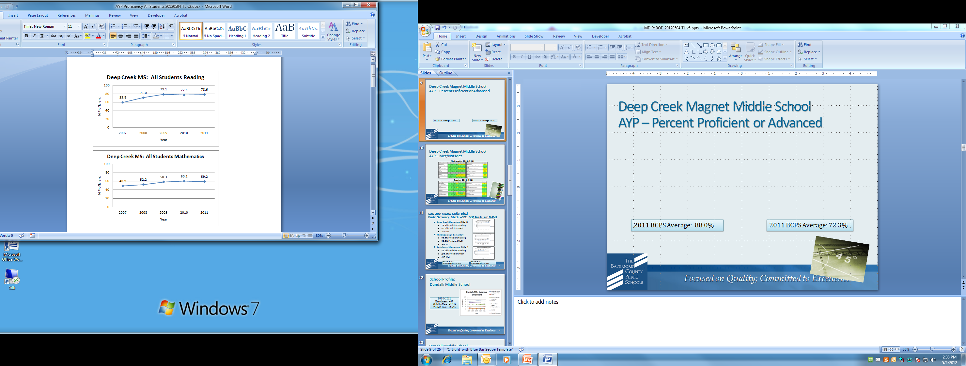

Deep Creek Magnet Middle School
AYP – Percent Proficient or Advanced
2011 BCPS Average: 88.0%
2011 BCPS Average: 72.3%

Slide 10
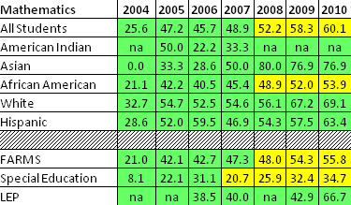
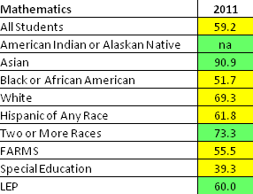
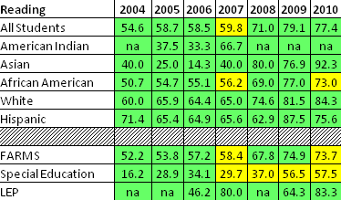
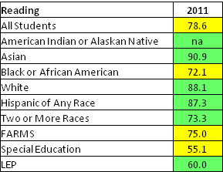

Deep Creek Magnet Middle School
AYP – Met/Not Met
Mathematics 2004 - 2011
Reading 2004 - 2011

Slide 11
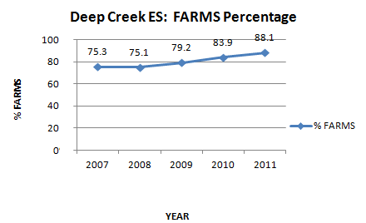
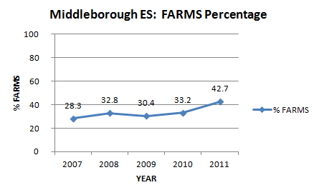
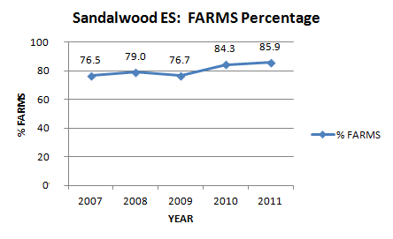
Deep Creek Magnet Middle School
Feeder Elementary Schools – 2011 MSA Results and FARMS
Deep Creek Elementary (Title I)
  79.9% Proficient Reading
  86.8% Proficient Math
  AYP Met
Middleborough Elementary
  95.3% Proficient Reading
  93.0% Proficient Math
  AYP Met
Sandalwood Elementary (Title I)
  85.1% Proficient Reading
  >95.0% Proficient Math
  AYP Met
2011 MSA Reading:
BCPS Average Prof./Adv. 90.3%
2011 MSA Reading
BCPS Average Prof./Adv. 88.8%

Slide 12

School Profile:
Dundalk Middle School
2010-2011
Enrollment: 467
Mobility Rate : 42.2%
FARMS Rate: 76.2%

Slide 13
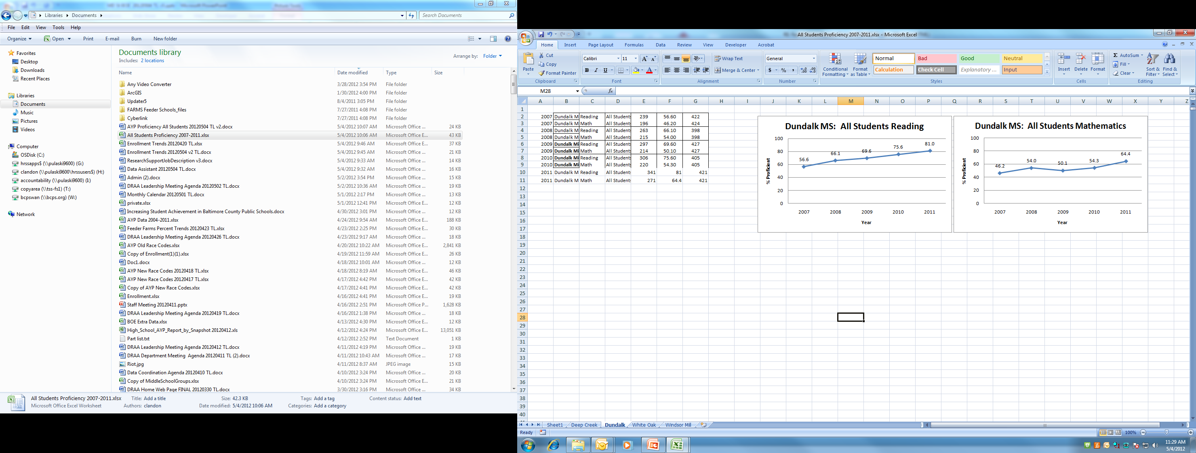
Dundalk Middle School
AYP – Percent Proficient or Advanced
2011 BCPS Average: 88.0%
2011 BCPS Average: 72.3%

Slide 14
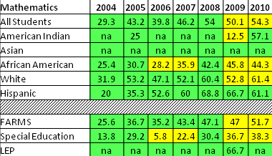
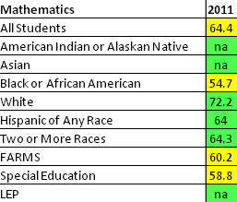
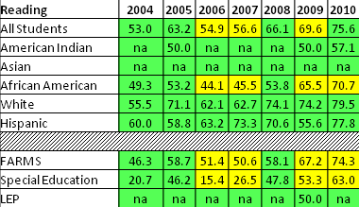
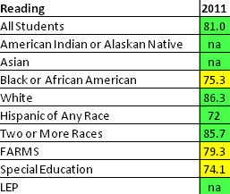
Dundalk Middle School
AYP – Met/Not Met
Mathematics 2004 - 2011
Reading 2004 - 2011

Slide 15
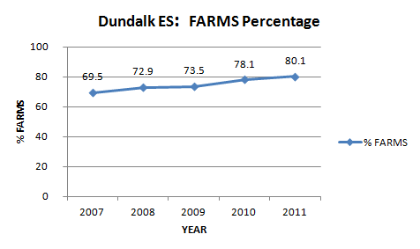
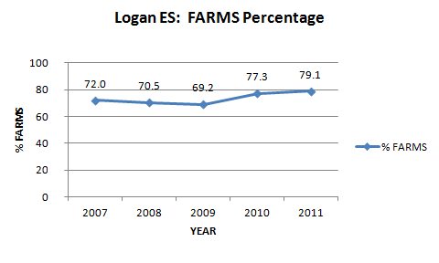
Dundalk Middle School
Feeder Elementary Schools – 2011 MSA Results and FARMS
Dundalk Elementary (Title I)
  82.8% Proficient Reading
  88.8% Proficient Math
  AYP Not Met in Reading
Logan Elementary (Title I)
  84.1% Proficient Reading
  86.2% Proficient Math
  AYP Met
2011 MSA Reading:
BCPS Average Prof./Adv. 90.3%
2011 MSA Mathematics:
BCPS Average Prof./Adv. 88.8%

Slide 16
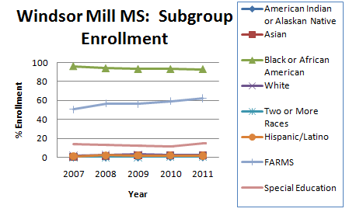
School Profile:
Windsor Mill Middle School
2010-2011
Enrollment: 624
Mobility Rate: 25.7%
FARMS Rate: 62.8%

Slide 17
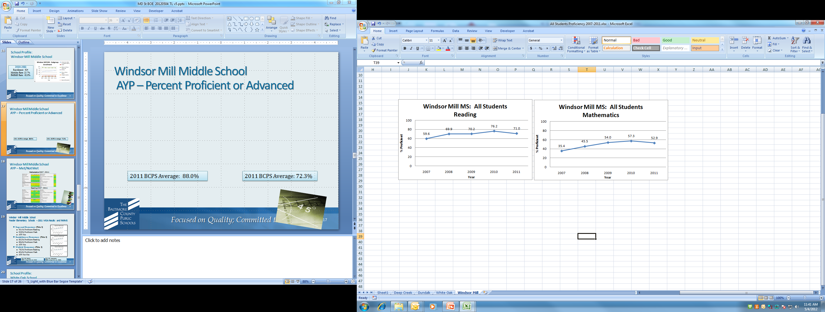
Windsor Mill Middle School
AYP – Percent Proficient or Advanced
2011 BCPS Average: 88.0%
2011 BCPS Average: 72.3%

Slide 18
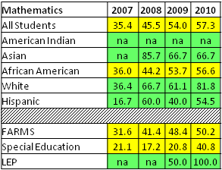
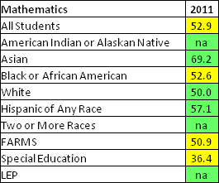
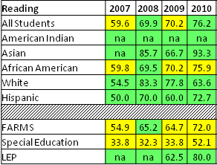
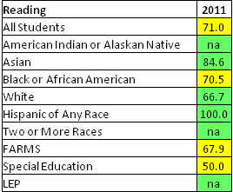
Windsor Mill Middle School
AYP – Met/Not Met
Mathematics 2007 - 2011
Reading 2007 - 2011

Slide 19
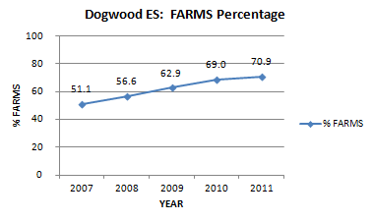
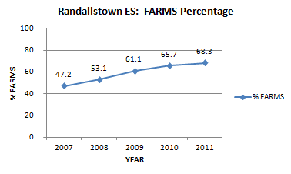
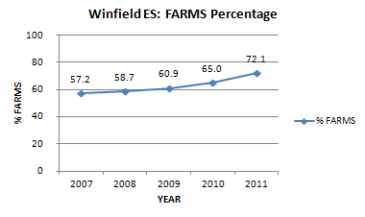
Windsor Mill Middle School
Feeder Elementary Schools – 2011 MSA Results and FARMS
Dogwood Elementary (Title I)
  93.1% Proficient Reading
  93.5% Proficient Math
  AYP Met
Randallstown Elementary (Title I)
  83.2% Proficient Reading
  88.4% Proficient Math
  AYP Met
Winfield Elementary (Title I)
  78.2% Proficient Reading
  69.4% Proficient Math
  AYP Not Met
2011 MSA Reading:
BCPS Average Prof./Adv. 90.3%
2011 MSA Mathematics:
BCPS Average Prof./Adv. 88.8%

Slide 20
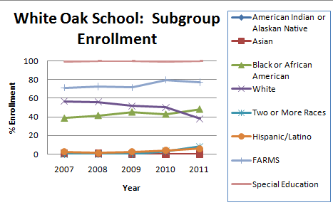
School Profile:
White Oak School
2010-2011
Enrollment: 62
Mobility Rate: > 95.0%
FARMS Rate: 79.8%

Slide 21
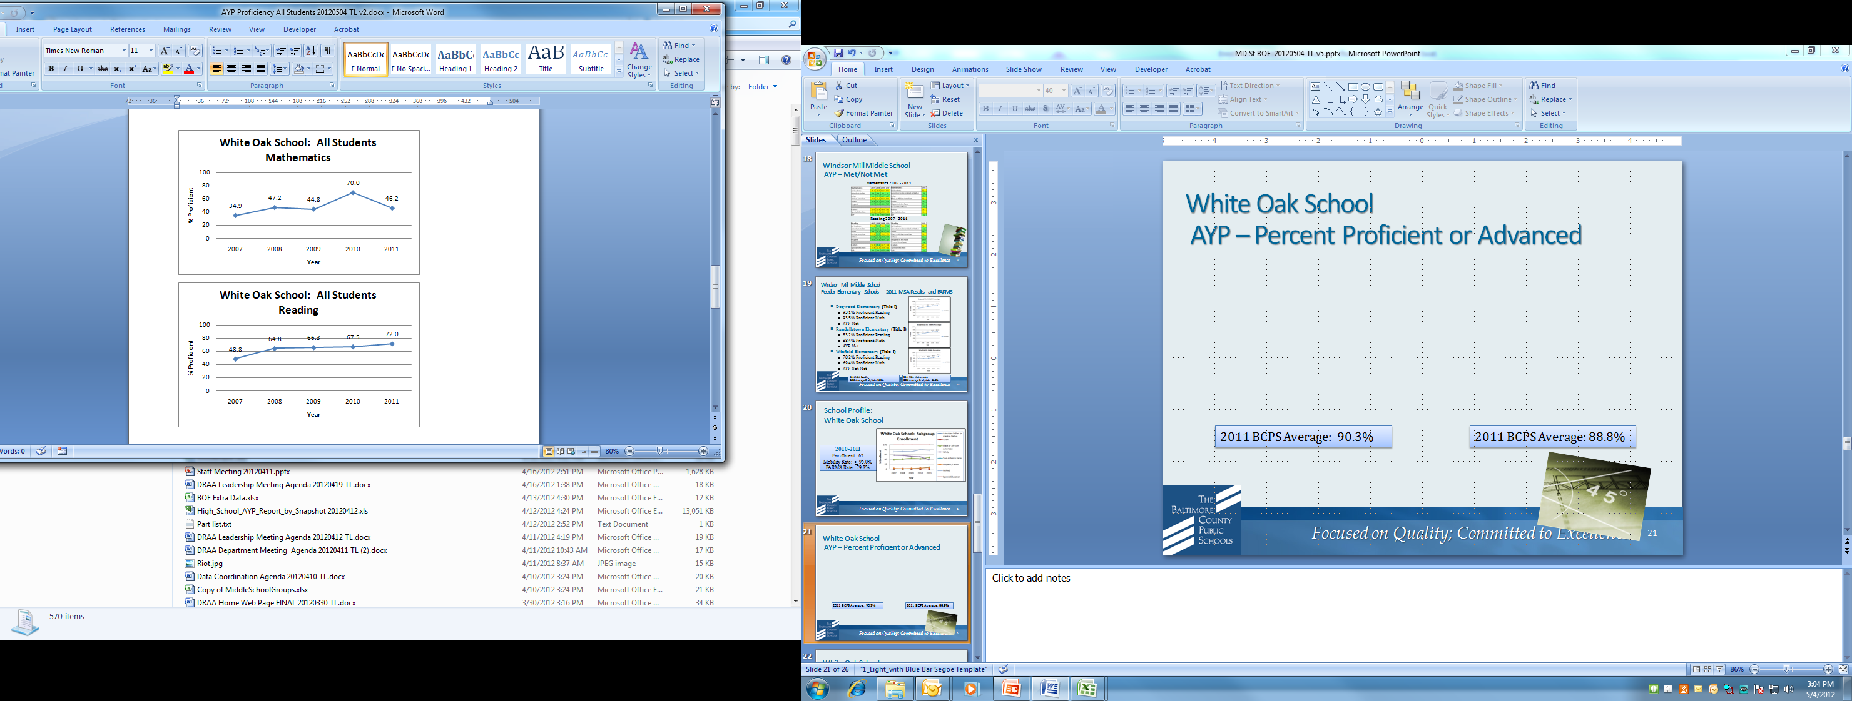
White Oak School
AYP – Percent Proficient or Advanced
2011 BCPS Average: 90.3%
2011 BCPS Average: 88.8%

Slide 22
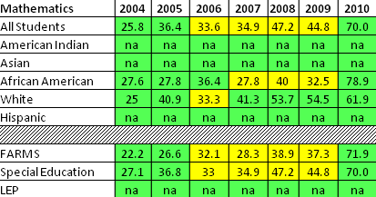
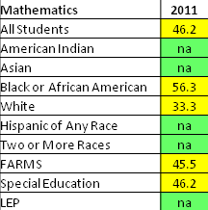
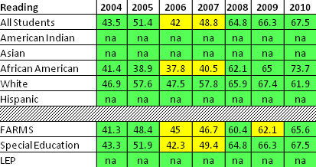
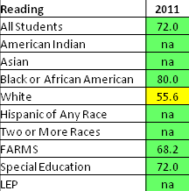
White Oak School
AYP – Met/Not Met
Mathematics 2007 - 2011
Reading 2007 - 2011

Slide 23
Key Reforms
  Deep Creek Magnet Middle School
  Dundalk Middle School
  Windsor Mill Middle School
  Mathematics, Reading , and Data Monitoring
  and Analysis
      Master Schedule
  School Culture
    AVID
    Action Team

Slide 24

Key Reforms
  White Oak School
  Mathematics and Reading
    Professional Development
  Data Monitoring and Analysis
      Master Schedule

Slide 25

District Supports for Restructuring Schools
Assistant superintendents
Alternative Governance Committee
Two-year commitment to additional resources
Ongoing support and monitoring

Slide 26
Closure & Questions

