Slide 1
Alternative Governance Proposal
Presented to the Maryland State Board of Education
Dr. Joshua P. Starr, Superintendent
May 22, 2012
Notes:
Dr. Starr introduces MCPS staff that are in the audience:
Dr. Darryl Williams, Community Superintendent
Board member?
Mr. Brian Edwards, Chief of Staff ?
Mr. Art Williams, Principal of Forest Oak Middle School
FOMS PTA president?
Mrs. Vicky Parcan, Principal of Neelsville Middle School
NMS PTA president?
Dr. Kathy Brake, Director of School Performance
Ms. Debra Mugge, President, Montgomery County Association of Administrators and Principals
Mr. Doug Prouty, President, Montgomery County Education Association
Mrs. Barbara Friedlander, School Improvement Specialist

Slide 2
The Alternative Governance Proposals for
Forest Oak Middle School
Neelsville Middle School
Approved by the MCPS Board of Education on
March 26 ,2012
Notes:
Dr. Starr
Vicky Parcan and Art Williams presented their school’s Alternative Governance Proposals to the MCPS Board of Education on March 26 and the plans were approved at that meeting.

Slide 3
Restructuring Option 1
Replace all or most of the school staff, which may include the principal, who are relevant to the school’s inability to make adequate progress.
Notes:
Dr. Starr
A committee of stakeholders that included principals, teachers, and supporting staff from across the county as well as central office staff met during the year of corrective action to determine the restructuring option that would best meet the needs of our schools.
The committee lead the way for the Alternative Governance Board to develop, implement, and monitor the best practices for restructuring our two schools.

Slide 4
Forest Oak Middle School
Student Demographics
Subgroup | % AM | % BL | % AS | % HI | % PI | % WH | % MU | % Male | % Female | % ESOL | % FARMS | % SPED | % Ever FARMS
All Students | 0.3 | 25.3 | 9.9 | 41.3 | 0.0 | 18.0 | 5.2 | 52.7 | 47.3 | 8.3 | 51.7 | 13.6 | 64.9
ESOL | 0.0 | 24.6 | 6.2 | 67.7 | 0.0 | 1.5 | 0.0 | 40.0 | 60.0
FARMS | 0.0 | 30.7 | 5.7 | 56.0 | 0.0 | 2.5 | 5.2 | 48.9 | 51.1
SPED | 0.9 | 27.1 | 6.5 | 48.6 | 0.0 | 13.1 | 3.7 | 75.7 | 24.3
Notes:
Darryl

Slide 5
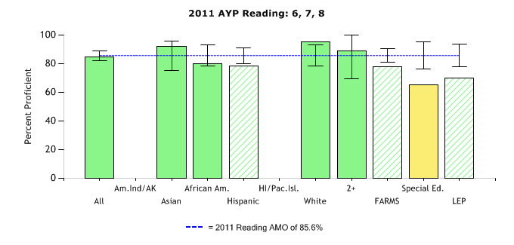
Notes:
Darryl

Slide 6
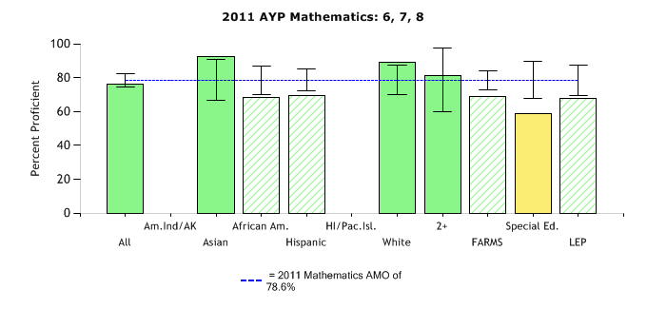
Notes:
Darryl

Slide 7
Forest Oak Middle School
Root Cause
Data Sources
Stakeholder Surveys including Students
Instructional Program Review
Formative and Summative Assessments
Instructional Walkthroughs
Notes:
Darryl

Slide 8
Forest Oak Middle School
Student and Stakeholder Focus
Monitoring Student Attendance
Engaging and Rigorous Instruction
Effective Instructional Leadership
Professional Development
Notes:
Darryl

Slide 9
Forest Oak Middle School
Program Proposal
Collaborative Cohort Work
Shared Leadership Team Institute
Professional Learning Communities Institute
Full Time Staff Development Teacher
Fully Released Math Resource Teacher
Notes:
Darryl

Slide 10
Forest Oak Middle School
Program Proposal
Advancement Via Individual Determination (AVID)
Additional Elective Courses
Extended Learning Opportunities
Notes:
Darryl

Slide 11
Neelsville Middle School
All Student Demographics
Subgroup | % AM | % BL | % AS | % HI | % PI | % WH | % MU | % Male | % Female | % ESOL | % FARMS | % SPED | % Ever FARMS
All Students | 0.2 | 35.6 | 10.7 | 37.4 | 0.2 | 10.4 | 5.4 | 50.6 | 49.4 | 7.2 | 56.7 | 10.9 | 70.3
ESOL | 0.0 | 18.0 | 16.4 | 63.9 | 0.0 | 1.6 | 0.0 | 50.8 | 49.2
FARMS | 0.0 | 42.1 | 6.4 | 47.9 | 0.0 | 1.2 | 2.3 | 48.8 | 51.2
SPED | 0.0 | 40.9 | 1.1 | 39.8 | 0.0 | 14.0 | 4.3 | 67.7 | 32.3
Notes:
Darryl

Slide 12
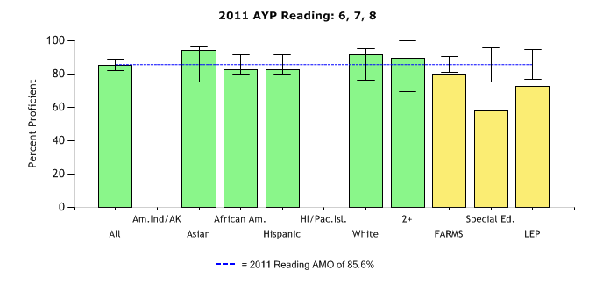
Notes:
Darryl

Slide 13
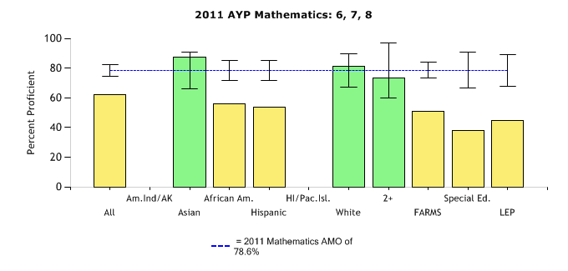
Notes:
Darryl

Slide 14
Neelsville Middle School
Instructional Program Review
Root Cause
Data Sources
Study
Circles
Stakeholder Surveys including Students
Instructional Walkthroughs
Formative and Summative Assessments
Notes:
Darryl

Slide 15
Neelsville Middle School
Student and Stakeholder Focus
Positive Learning Environment
Rigorous Instruction
Culturally and Racially Responsive Instruction
High Expectations
Notes:
Darryl

Slide 16
Neelsville Middle School
Program Proposal
IB Middle Years Programme
Shared Leadership Team Institute
Professional Learning Communities Institute
Full Time Staff Development Teacher
Fully Released Math Resource Teacher
Additional Elective Courses
Extended Learning Opportunities
Notes:
Darryl

Slide 17
Support, Monitoring, and Evaluation
Continued Collaboration:
  Alternative Governance Board
  Achievement Steering Committee
Multiple Measures:
  Formative and Summative Assessments
  Walkthroughs
  Staff Survey on restructuring process to determine
  lessons learned
Notes:
Darryl

Slide 18
School Improvement
“The most promising strategy for sustained substantive school improvement is developing the ability of school personnel to function as
professional learning communities.”
Rick DuFour
Notes:
Darryl

