Slide 1
RTTT Project 27 Dashboard Overview of Student Alerts
Rob London & Pat Mikos
Division of Accountability, Assessment, and Data Systems (DAADS)

Slide 2
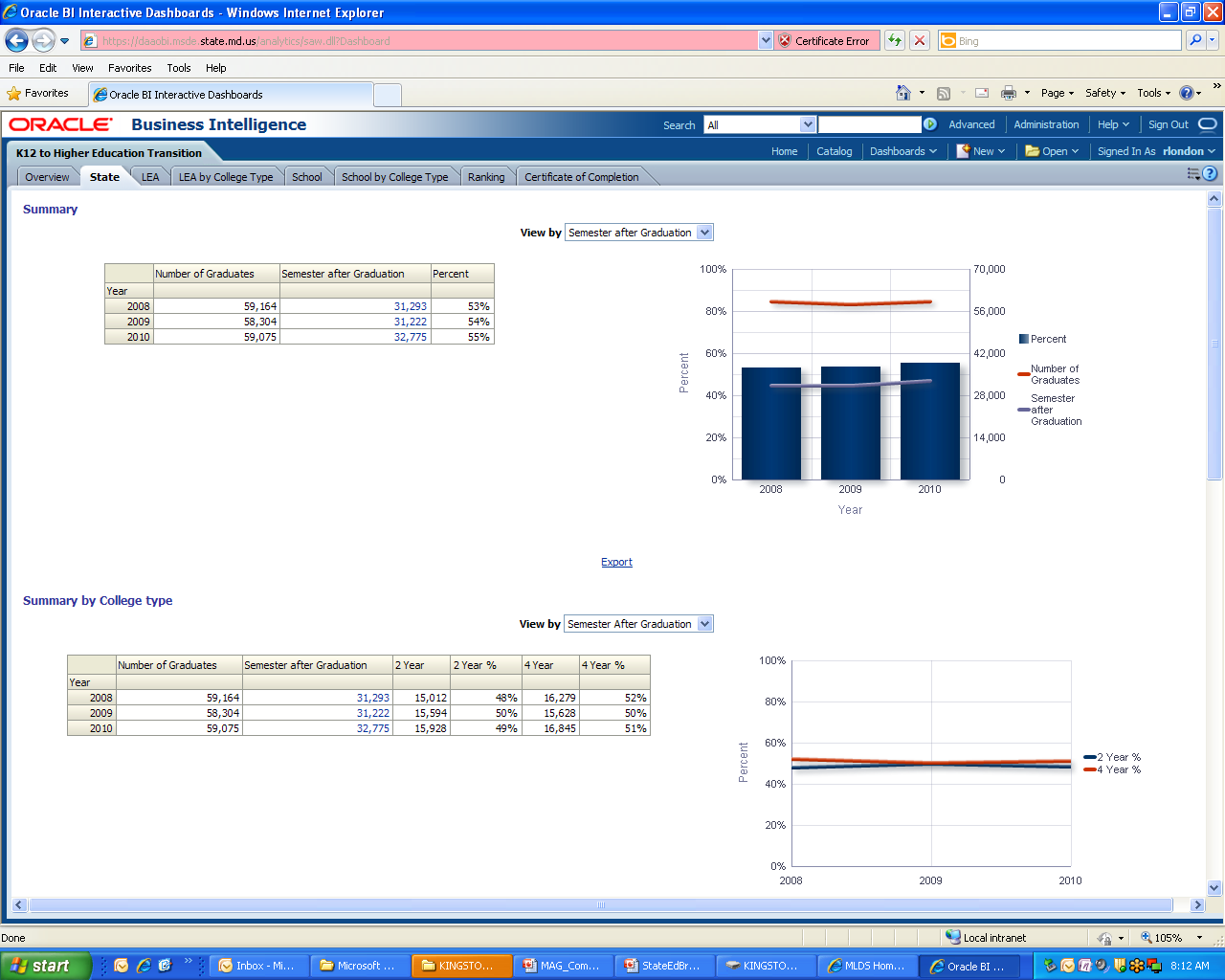
Overview
RTTT Project 27 is 3 year development of over 125 data presentation dashboards covering 36 performance subject areas
Year 1 Student High Risk Alerts dashboard is designed to provide a general indication that a student might be at risk for insufficient progress.

Slide 3
Summary
The student alert indicator is a weighted average a variety of factors that were selected based on a combination of;
Best-practices of other states and several MD LEAs including; Massachusetts, South Carolina, Maine, Illinois, New York, Prince George's County, and Baltimore City.
US Dept. of Education IES research,
MSDE and LEA experience of select subject matter experts.
The alerts dashboard written requirements have been completed and being discussed with a variety of MSDE and LEA subject matter experts while a dashboard mockup is being developed.

Slide 4
Alerts Indicators
The alerts indicator is a weighted average of factors that are stored in a control table. This allows for:
Factors to be weighted based on our research and experience;
Factors that are not used to be zeroed out; and
Factors can be defined by grade bands.
The weighted average alerts indicator consists of 7-10 factors depending on grade. The main factors include; MMSR/MSA/HSA, credits, attendance, disciplinary events, mobility, cohort, access to pre-k, special services, and dropout/withdrawal events.
Disciplinary factor is a count of select disciplinary events that are reported from the our disciplinary file (annual report).
For the full description, see “Functional Requirements Document Student High Risk Alerts”.

Slide 5
Alert System for Students At Risk

Slide 6
Alert System for Students At Risk
Student Composite Index (SCI) includes weighted factors
State - LEA - School - and Student-Level Reports
Includes 3-year calculations and trend data
On-going analysis and research to improve the model

Slide 7
Next Steps in the Dashboard Process
On-going dashboard development with MSDE-LEA collaboration review team for feedback and design modifications.
Next steps in our formal dashboard development process are:
Complete proof-of-concept dashboard
Modify the proof-of-concept and do a quality assurance assessment on available data
Prepare multi-media overview of the dashboard
Define the security access specifications for the dashboard
Perform a user acceptance test with the LEAs collaboration team
Plan the rollout with executive approval for dashboard release.
Conduct LEA webinar to initiate rollout.

