Slide 1
Maryland School Assessment
(MSA)
2010 Results
Leslie Wilson, Assistant State Superintendent
Division of Accountability and Assessment
July 20, 2010
State Board of Education
Notes:
Meeting the requirements of NCLB is our floor, not our ceiling. Proficient is not enough for the majority of our students, they are capable of much more.
To meet the challenges of globalization and emphasize growing our own talent we must raise the expectations we have for many of our students.
Strategic plan contains goals for AP, PSAT and SAT participation and performance to raise standards for student achievement
While our students perform well in comparison to other states, we need improvement to make our goals, and cannot be discouraged by lower scores as we increase participation
This report will highlight some important conclusions we have made from our data, and how we might use them to better boost the performance of our students.

Slide 2
2010 Maryland School Assessment
Assesses reading and mathematics
Administered in Grades 3-8
  362,900 students
Students receive a score of Basic, Proficient or Advanced
Fulfills No Child Left Behind requirements, used to determine school Adequate Yearly Progress (AYP)
100% of students must score proficient by 2014

Slide 3
2010 MSA Summary
Continued progress
Many LEAs maintaining high performance
Increments of improvement are smaller
Historically lower-performing subgroups continue to make good progress.

Slide 4
Range of Performance of LEAs
Number of LEAs with MSA Proficient/Advanced Scores in Upper Score Ranges
Content and Level | 80-84.9% | 85-89.9% | 90 and Above | Total 80 and Above
Elementary
Reading | 1 | 12 | 8 | 21
Mathematics | 3 | 10 | 8 | 21
Middle
Reading | 8 | 6 | 5 | 19
Mathematics | 7 | 3 | 0 | 10

Slide 5
Third-Grade Cohorts
Reading
% Proficient + Advanced
Math
% Proficient + Advanced
Notes:
In a just-released national report from the College Board, we are especially proud that Maryland’s AP program received considerable praise.
Maryland was cited as leading the nation in the percentage of students in the Class of 2005 who had earned an AP exam score of 3 or better. Maryland had 21 percent, second only to NY.

Slide 6
Early Learning Foundations for Success
 | Third Grade MSA Results (proficient or better) | 2003 | 2010
 | Reading | 58.1% | 84.0%
 | Mathematics | 65.1% | 86.0%
 | Readiness Programs
Pre-kindergarten for 4-year olds from “economically disadvantaged backgrounds” |  | Limited | Yes
Kindergarten |  | Half-day | Full-day
All Early Learning Programs coordinated by MSDE |  | No | Yes
Prepared to Enter First Grade Ready to Learn (Maryland Model for School Readiness) |  | 52% ready | 78% ready

Slide 7
State Curriculum Assures Continuity
Statewide K-12 Curriculum Standards
 |  | Third Grade MSA Results (proficient or better) | 2003 | 2010
 |  | Reading | 58.1% | 84.0%
 |  | Mathematics | 65.1% | 86.0%
Cumulative Impact of State Curriculum on Teaching and Learning
 | Grades students experiencing instructional continuity with State Curriculum |  | 3 | K-3
 | Teachers Experienced with State Curriculum |  | 1 year | 8 years

Slide 8
Bridge to Excellence (BTE)
 | Third Grade MSA Results (proficient or better) | 2003 | 2010
Reading |  | 58.1% | 84.0%
Mathematics |  | 65.1% | 86.0%
 | Cumulative Impact of Bridge to Excellence on Teaching and Learning
State Education Aid |  | $ 2.5 bil. | $4.6 bil.
Local School System Master Plans |  | 1 year | 8 years

Slide 9
Highly Qualified Teachers (HQT)
 | Third Grade MSA Results (proficient or better) | 2004 | 2010
 | Reading | 71.0% | 84.0%
 | Mathematics | 72.2% | 86.0%
 |  | 2004 | 2009*
Classes Taught by Highly Qualified Teachers (HQT)
 | All Classes | 66.9% | 88.5%
 | Elementary – High Poverty Schools | 46.6% | 79%
New Nationally Board Certified Teachers |  | 158 | 305
* 2010 data not comparable – USDE changed calculation

Slide 10
Elementary Progress:
Elementary Reading
  Scores remain stable at all grades
  First small decrease in Grade 3
  Subgroups stable, small gains for Hispanic and ELL groups.
Elementary Math
  Small gains at all three grade levels
  All subgroups show gains.

Slide 11
Elementary Gains
Reading and Math
Reading 2003-2010
Math 2003-2010
25-point gain since 2003
26.5-point gain since 2003
Notes:
In a just-released national report from the College Board, we are especially proud that Maryland’s AP program received considerable praise.
Maryland was cited as leading the nation in the percentage of students in the Class of 2005 who had earned an AP exam score of 3 or better. Maryland had 21 percent, second only to NY.

Slide 12
Middle School Progress
2009 to 2010
Middle School Reading
  Gains at Grade 6, Grades 7 and 8 were stable
  All subgroups show progress.
Middle School Math
  Gains at Grade 6 and 7, Grade 8 was stable
  All subgroups show progress but ELL.

Slide 13
Middle School
Reading 2003-2010
Math 2003-2010
23-point gain since 2003
33-point gain since 2003
Notes:
In a just-released national report from the College Board, we are especially proud that Maryland’s AP program received considerable praise.
Maryland was cited as leading the nation in the percentage of students in the Class of 2005 who had earned an AP exam score of 3 or better. Maryland had 21 percent, second only to NY.

Slide 14
2010 MSA: Services groups
Services subgroups made progress in every area but ELL in middle school math and Special Education in elementary reading.
Continue to close achievement gaps
Most significant gains
  Middle school reading and elementary math (all groups)
It is harder to erase early deficits in later years.

Slide 15
2003-2010 Gap Reductions
Group | Elementary Reading | Elementary Math | Middle Reading | Middle Math
FARMS | 19.1 | 19.1 | 16.0 | 8.4
ELL | 29.1 | 14.9 | 12.3 | -9.1
Special Education | 13.8 | 7.0 | 12.9 | 0.2
African American | 17.3 | 18.3 | 17.2 | 8.4
Hispanic | 19.9 | 14.8 | 15.7 | 6.4

Slide 16
Elementary Reading
Closing achievement gaps for all races

Slide 17
Elementary Math
Closing achievement gaps for all races

Slide 18
African American Students
Almost 8 in 10 proficient in Elementary Math
14.8 points
33.1 points

Slide 19
The Achievement Gap:
ELL, Elementary Reading
14.1 points
43.1 points

Slide 20
The Achievement Gap:
FARMS, Elementary Math
14.1 points
33.1 points

Slide 21
The Achievement Gap:
Special Education, Middle School Reading
32.9 points
45.6 points

Slide 22
New Race Codes for 2011
Current Race Codes
New Race Codes
American Indian/Alaskan
Asian
African American
White
Hispanic
Hispanic/Latino
American Indian/Alaskan
Asian
African American
Native Hawaiian/Pacific Islander
White
Two or more races

Slide 23
Adequate Yearly Progress
(AYP)
2010 Results
Leslie Wilson, Assistant Superintendent
Division of Accountability and Assessment
July 20, 2010
State Board of Education
Notes:
Meeting the requirements of NCLB is our floor, not our ceiling. Proficient is not enough for the majority of our students, they are capable of much more.
To meet the challenges of globalization and emphasize growing our own talent we must raise the expectations we have for many of our students.
Strategic plan contains goals for AP, PSAT and SAT participation and performance to raise standards for student achievement
While our students perform well in comparison to other states, we need improvement to make our goals, and cannot be discouraged by lower scores as we increase participation
This report will highlight some important conclusions we have made from our data, and how we might use them to better boost the performance of our students.

Slide 24
What is “AYP”
Adequate Yearly Progress – sufficient progress toward the goal of 100% proficient by 2014.
Determination of school success based on No Child Left Behind
Uses MSA results and attendance data
Schools must meet a yearly target (AMO)
Must meet target for each of 8 subgroups

Slide 25
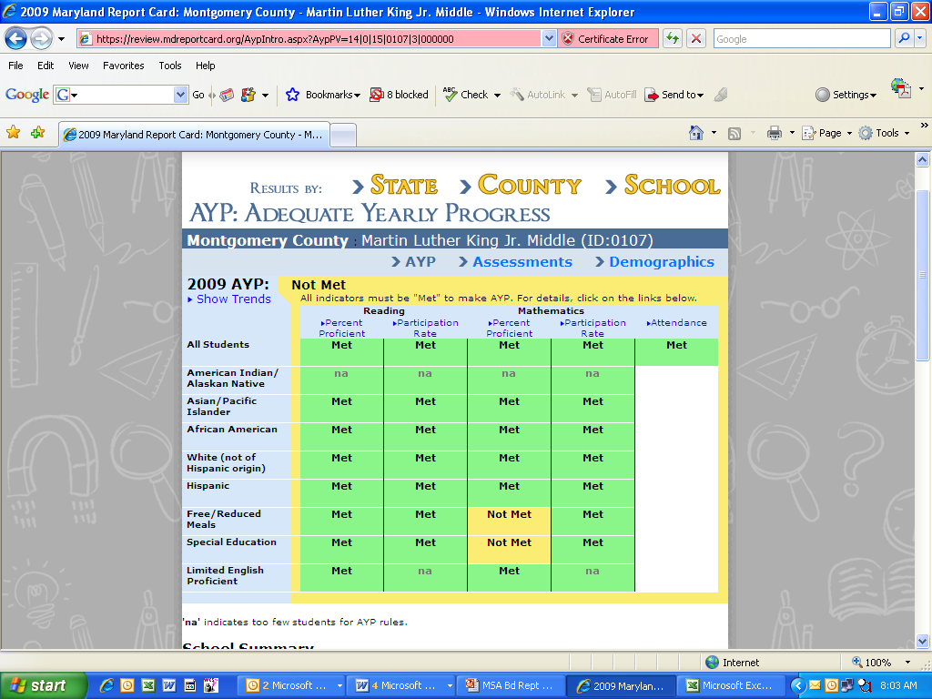
Sample AYP Chart
2010 AYP

Slide 26
Challenges to Achieving AYP
Target rises each year
Confidence interval shrinks each year
All subgroups must achieve targets
  Subgroups with 5 students or more counted
  In 2011 we will have 10 subgroups instead of the 8 we have had in the past
Students receiving special services
  Challenged to achieve targets

Slide 27
2010 AYP Breakdown
AYP Category | Number | Percent *
Met AYP | 783 | 69.9
In School Improvement | 19 | 1.7
Exit School Improvement | 10 | 0.9
Not Met AYP | 337 | 30.1
Local Attention | 181 | 16.2
School Improvement | 156 | 13.9
Total | 1120
* Percentage is of total number of schools

Slide 28
AYP Results
10 schools exit School Improvement
175 schools currently in Sch. Improvement
  17 more than 2009
119 of the 136 schools (88%) that missed last year did not enter school improvement
181 schools missed AYP for the first time
Special education subgroups account for 77 percent of schools not meeting AYP because of only one subgroup.

Slide 29
School Improvement Categories
STAGES | PATHWAYS
 | Comprehensive Needs Pathway | Focused Needs Pathway
Developing Stage | Failing: -All students or -3+ subgroups | Failing: -1 to 2 subgroups
Priority Stage

Slide 30
School Improvement Categories
STAGES | PATHWAYS
 | Comprehensive Needs Pathway | Focused Needs Pathway
Developing Stage | Schools enter after not achieving AYP two times | Schools enter after not achieving AYP two times
Priority Stage | Schools enter when AYP failed fifth time | Schools enter when AYP failed fifth time

Slide 31
Schools in Improvement
STAGES | PATHWAYS
 | Comprehensive Needs Pathway | Focused Needs Pathway
Developing Stage | 2009 - 41 schools 2010 – 78 schools | 2009 - 37 schools 2010 – 22 schools
Priority Stage | 2009 - 71 schools 2010 – 73 schools | 2009 - 8 schools 2010 – 2 schools

Slide 32
Summary
Student performance continues to improve,
  gains not as dramatic as LEAs maintain high scores
Achievement gaps continue closing
  students receiving services still have challenges
Local attention works
Evidence of more schools not meeting AYP
  often because of special education subgroups only.

Slide 33
Vision for the Future:
Common Core Standards
Md. has adopted the Common Core Standards and is a governing state in their consortium to develop a national assessment
  Allow valid comparison among states
  Ensure students are college or work ready
  Ensure competitiveness in a global economy
Will transition to Common Core Standards curriculum
Expect to implement new tests in 2014-2015

Slide 34
Questions and Discussion
State Board of Education
Notes:
Meeting the requirements of NCLB is our floor, not our ceiling. Proficient is not enough for the majority of our students, they are capable of much more.
To meet the challenges of globalization and emphasize growing our own talent we must raise the expectations we have for many of our students.
Strategic plan contains goals for AP, PSAT and SAT participation and performance to raise standards for student achievement
While our students perform well in comparison to other states, we need improvement to make our goals, and cannot be discouraged by lower scores as we increase participation
This report will highlight some important conclusions we have made from our data, and how we might use them to better boost the performance of our students.

