Slide 1
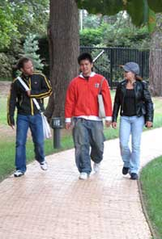
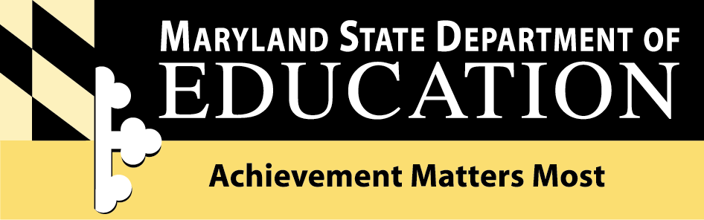
Maryland Career and Technology Education Status Report
Presentation to the Maryland State Board of Education
March 23, 2010
Katharine M. Oliver
Assistant State Superintendent
Division of Career and College Readiness

Slide 2
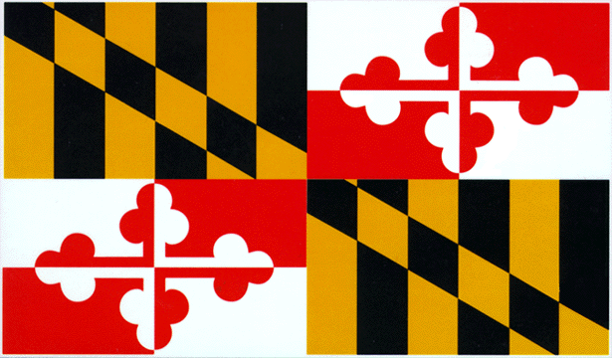
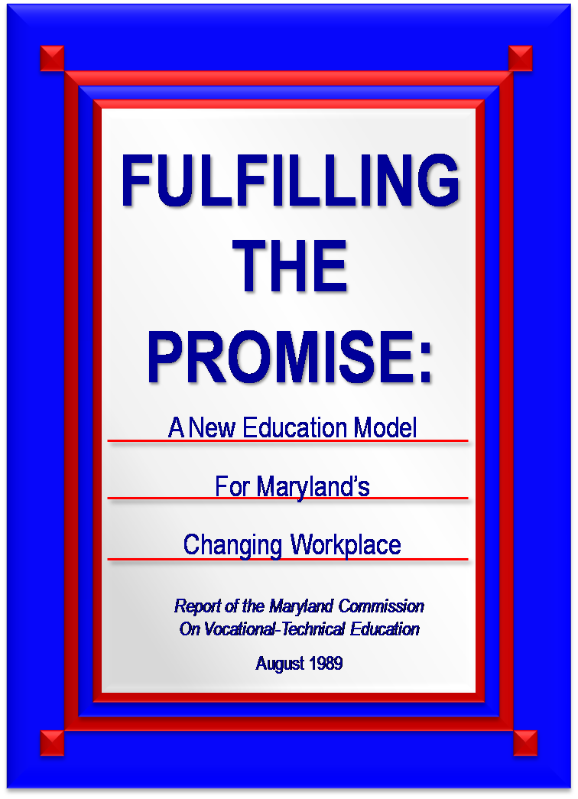
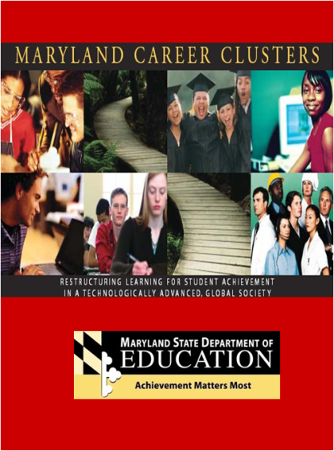
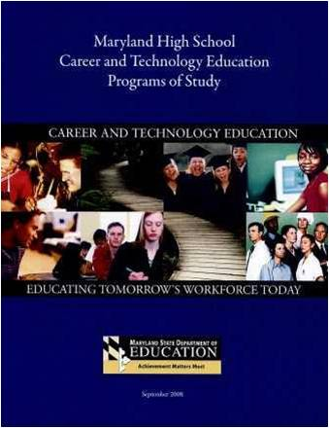
Maryland CTE is a Critical Component of Education Reform

Slide 3
21st Century CTE
    Today’s CTE prepares students for both college and careers through rigorous programs of study.
    The focus has moved from preparing students with trade specific skills to preparing them with academic and technical knowledge to be successful in a wide range of career opportunities (and advanced education and training).
    Increased accountability supports CTE program improvement with an emphasis on academic and technical skill attainment (industry certification) – College and Career Readiness

Slide 4
High School Program |  |  |  |  |  | College Program
Requirements | Grade 9 | Grade 10 | Grade 11 | Grade 12 |  | English/Lang. Arts (__ Credits) Include AP options
English – 4 | English 9 | English 10 | English 11 | English 12
 |  |  | AP Language | AP Literature
 |  |  |  |  |  | Humanities/Social Studies (__ Credits) Include AP options
Social Studies - 3 | Us Govt. | World History | US History | Government
 |  | AP European | AP US History | AP Government
Mathematics - 4 | Algebra I | Geometry | Algebra II | Trigonometry or Pre-Calculus or Calculus or |  | Mathematics (__ Credits) Include AP options
 |  |  |  | AP Calculus
Science - 3 | Earth or Physical Sci. | Biology or | Chemistry or | Physics or
 |  |  |  |  |  | Science (__Credits) Include AP Options
 |  | AP Biology | AP Chemistry | AP Physics
Phys Ed. - .5/ Health Ed. - .5 | .5 Phys Ed. | .5 Health
Fine Arts - 1 | .5 Fine Arts | .5 Fine Arts
 |  |  |  |  |  | Career Program Concentration (__Credits) Include Articulation Options, Dual Enrollment, Credit by Exam and Pre-apprenticeship
Tech Ed | Foundations To Technology
CTE Completer - 4 |  | CTE Program Sequence
 |  | CTE Course (1) | CTE Course (1) | CTE Courses (2)
Foreign Lang. - 2 and/or Adv. Tech Ed. - 2 | Language Spanish I | Language Spanish II | Language AP Spanish | Advance Technology Education

Slide 5
Maryland CTE Today
Half (50%) of all grade 10-12 high school students enroll in CTE courses (107,615)
20% of the class of 2009 completed a CTE program of study (11,786)
48% of the CTE graduates also completed the coursework for entrance to USM, this is considered a “Dual Completer” (5,694)

Slide 6
CTE in Maryland:
Getting Results
  Federal Accountability Measures: Carl D. Perkins Career and Technical Education Act of 2006
  Maryland Accountability Measures

Slide 7


CTE Federal Accountability Measures
Academic Attainment: Reading/Language Arts & Mathematics
Technical Skill Attainment
Secondary School Completion
Student Graduation Rate
Secondary Placement
Non-Traditional Participation & Completion

Slide 8
HSA Proficiency Gains in CTE

Slide 9
Students Achieving Industry Standards

Slide 10
CTE Graduation Rate

Slide 11
Grade 10-12 CTE Graduation Rate

Slide 12
CTE Placement:
Transitioning to College and Careers

Slide 13
Non-Traditional Placement and Completion

Slide 14
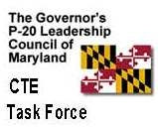
CTE State Results
MSDE Achievement Matters Most– Managing For Results
  Participation and performance of all high school student subgroups in challenging instructional programs -- Dual Completion (CTE/USM)
Education Week – Quality Counts
  #1 in Transitions & Alignment, aligning preK-12 standards with early learning & college and career expectations. Score/Grade: 96.4%/A
P-20 Leadership Council – CTE Task Force
  Expand CTE program offerings to ensure responsiveness to economic and workforce development needs and provide career opportunities for all Maryland students.
  Ensure academic and technical rigor of CTE programs that prepare Maryland high school graduates for successful transition to college and careers.
  Increase access to CTE programs so that all of Maryland’s students have opportunities for career preparation and are provided support for successful transition from high school to college and careers.
4%

Slide 15
Access, Rigor and Expansion
48 CTE Programs of Study
Arts, Media, & Communication
Business, Management & Finance
Construction & Development
Consumer Services, Hospitality, & Tourism
Environmental, Agricultural, &
Natural Resources Systems
Health & Biosciences
Human Resource Services
Information Technology
Manufacturing, Engineering & Technology
Transportation Technologies

Slide 16
CTE State Programs of Study

Slide 17
STEM – Related CTE

Slide 18
BRAC-Related CTE

Slide 19
Dual Completion for
CTE Programs of Study

Slide 20

PLTW High School Completion by Race/Ethnicity
State:
48.31%

Slide 21
Continuing the Progress
Complete development of 48 CTE Programs of Study
  Support/incentives for school system adoption of programs
  Expand partnership with Higher Education for CTE Program Affiliates
Increase student access to industry certifications and early college credit related to the CTE program of study
  Ensure alignment to academic and technical standards for college and career readiness
  Support school system coordination and administration of technical assessments (assessment centers and funding for students)
Providing accurate and timely performance data for the continuous improvement of Maryland’s system of CTE
  Align federal/state measures as part of continued development of the LDS
  Secure access to placement data to report postsecondary/employment after high school

