Slide 1
Teacher and Principal Evaluation Work Session May 9, 2013

Slide 2
Can we measure student growth ?
Maryland Tiered Achievement Index
Student Learning Objectives

Slide 3
TRSG Matrix showing typical objectionable pattern
Although this “Transformation, Status and Growth” weighting scheme was repeatedly preferred by the National Psychometric Council and accepted with reservations by the July 2012 Standard Setting Panel, diverse audiences argued TRSG would provide false positives for those beginning with high performing students and create false negatives for those beginning with lower performing students. LEA stress testing confirmed these concerns. TRSG had the virtue of a dynamic diagonal but over valued status.
TRSG was the 20% MSA placeholder until it was discarded in February 2013.

Slide 4
Maryland Tiered Achievement Index
Expands the premium “blue area” by one diagonal.
Expands the diagonal, protecting cells A3A1, P3P2, P2P1, and mitigating
A1P3.
Reflects the actual state distribution and is informed by the MSA underlying
technical structure

Slide 5
Calvert County’s approach to using the Standard Deviation to interpret performance
Performance spanning the grade mean by one standard deviation is considered expected and acceptable (green bracket).
Growth more than .5 STD above mean is beyond expected and commendable (blue bracket).
Performance .5 STD below the central range is concerning (yellow bracket); performance a full STD below mean is a significant loss and unacceptable (red bracket).
Slide borrowed from CCPS presentation, March 11, 2013

Slide 6
M-TAI 2 Means, STDs, and Tiers
Protecting the 10 cells that distinguish M-TAI 2 raises the means, from a minimum of .09 to a maximum of .2. The state means now center comfortably around 2.0: a year’s growth.
The Standard Deviations narrow slightly, from -.01 to -.08.
The perceptual result is that M-TAI 2 is more precise capturing high effective and ineffective performance.

Slide 7
Student Learning Objectives
Up to 50% of the evaluation may be based on SLOs
Recommend no less than two, no more than four SLOs for a teacher and/or principal
SLOs are equally weighted
SLO points are earned based on the degree to which achievement targets are met
Full attainment
Partial attainment
Insufficient attainment
Notes:
Posted here are the outcomes we want to achieve by the end of this meeting. We will focus with becoming familiar with the SLO components which automatically forces us to talk about the process for writing SLOs.
First, lets talk about… how did we got to this point…
Why are we talking about evaluating teachers in a different way and including a measure of student growth/progress?

Slide 8
A Student Learning Objective (S.L.O.) is…
…an instructional goal… for specific students…for a specific time interval
Focused on the most valuable learning
Aligned to current curriculum standards
Specific and measurable
Based on the most current student data
Adapted from New York State District-wide Growth Goal Setting Process – Road Map for Districts
Notes:
Quote From the Targeting Student Growth Document: ….
“Like well-constructed S.L.O.s, good instruction includes gathering data, setting goals based on that data, and assessing whether goals have been met”
TOP’s…. The SLO process is very similar to the action-research that many of you are doing as part of your teacher training.
Mentor Teachers…this is what many of you do every day…This is what the process for quality instruction looks like
Read this slide starting with middle circle: a Student Learning Objective is………
A teacher or principal will have 2-4 SLOs which will focus on the most valuable learning for that content and specific instructional interval.
Key decisions that may require support from a number of experts in your district:
How to determine the most critical content
How to analyze the data is important
How to assess student growth , progress or mastery is important
How to implement instructional strategies to get at instructional rigor is important
Note: Developing and using Student Learning Objectives is not a new strategy and is in use in some of our LEAS in Maryland already.

Slide 9
S.L.O. Process
STEP 1 - Data Review
STEP 2 – SLO Development
STEP 3 - Review and Approval Conference
STEP 4 - Mid-Interval Conference
STEP 5 - Final SLO Review
STEP 6 – Integration of SLO Results
STEP 7 – Professional Development
STEP 8 – Next steps

Slide 10
“Building the skills of teachers and principals to successfully implement SLOs is fundamental to success.” Community Training and Assistance Center
Notes:
Reinforce that MD is approaching the new evaluation system as a professional development tool and our commitment to support the local districts with PD.
SLOs will impact the principal-teacher relationship, the student-teacher relationship, teaching effectiveness and ultimately student achievement…. fidelity to the process of developing approving and scoring is vital to ensure fairness and consistency.
There are important benefits from implementing the SLO process….we believe in the power of the SLOs to support good instruction.
Community Training and Assistance Center (CTAC) addresses root causes of poverty at local, state and national levels by providing technical assistance, conducting research and evaluation, and supporting public policy initiatives in the fields of education and community development.
CTAC’s core education initiatives build the capacity of school districts, unions and states to analyze the conditions that help or hinder performance, find their causes, and create and implement improvement strategies, which address those causes and increase student achievement.
CTAC introduced Student Learning Objectives (SLOs) nationally through a groundbreaking partnership with Denver Public Schools in 1999. As the leading practitioner, trainer and evaluator of SLOs, we have assisted a number of districts and states with implementing successful SLO models. At the end of this PowerPoint, we have provided links to resources from CTAC for your use.

Slide 11
Can we attribute the growth of the student to the work of the teacher or principal ?
Individual Attribution
Collective Attribution
Shared Attribution

Slide 12
Attributing Individual Measures: MSAs

Slide 13
Attributions
For use with the MSA portion of evaluation
Not to be confused with testing accountability
The teacher(s) most directly responsible for the delivery of the instruction
Individual-based process with Principal
Eligible students: those registered on 9/30, present on the date of testing and in attendance 80% of the days in between
LEAs did not report significant problems

Slide 14
Attributing Collective Measures: School Progress Index

Slide 15
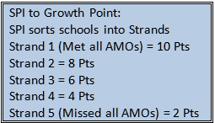
Maryland School Progress Index
Grades PreK-8
Grades 9-12
Meeting Performance Targets
(AMO)
Meeting Performance Targets
(AMO)
Achievement*
30%
Achievement*
40%
33.3%- Mathematics Proficiency (MSA)
33.3%- Reading Proficiency (MSA)
33.3%- Science Proficiency (MSA)
33.3%- Mathematics Proficiency (Algebra/Data Analysis HSA)
33.3%- English Proficiency (English SA)
33.3%- Science Proficiency (Biology HSA)
Gap*
40%
Gap*
40%
Gap between lowest subgroup and highest subgroup within a school:
Gap between lowest subgroup and highest subgroup within a school:
33.3%- Mathematics Proficiency (MSA)
33.3%- Reading Proficiency (MSA)
33.3%- Science Proficiency (MSA)
20%- Mathematics Proficiency (Algebra/
Data Analysis HSA)
20%- English Proficiency (English HSA)
20%- Science Proficiency (Biology HSA)
20%- Cohort Graduation Rate
20%- Cohort Dropout Rate
Growth*
30%
#College-and Career-Readiness*
20%
Percent of students making one year’s growth:
60%- Cohort Graduation rate
40%- College and Career Preparation (CCP)
Advanced Placement
Career and Technology Education (CTE) Concentrators
College Enrollment
50%- Mathematics Proficiency (MSA)
50%- Reading Proficiency (MSA)
*ALT-MSA is included in the index component

Slide 16
Translating SPI into Evaluation Percentage
The Strand identification is translated into the
proportional percentage points for evaluation
Strand | % Points
1 | 10
2 | 8
3 | 6
4 | 4
5 | 2

Slide 17
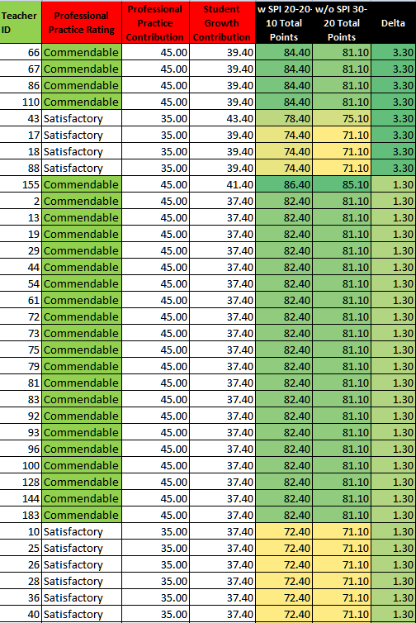
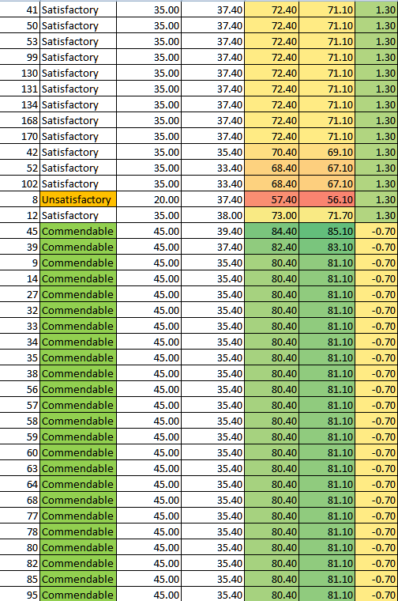
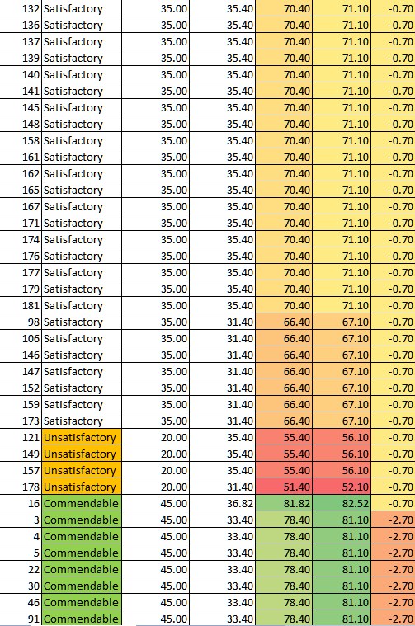
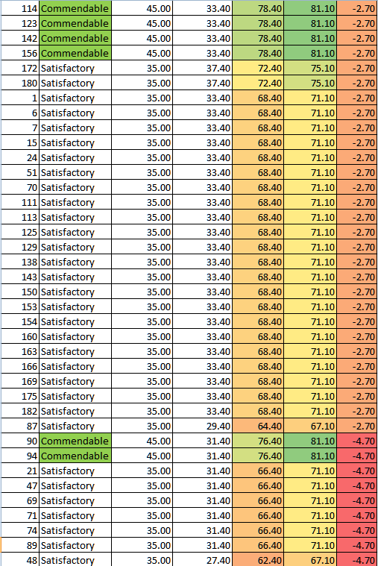
20% MSA & 30% SLO vs. 20% MSA/10% SPI/20% SLO Top 2 and bottom 2 panels sorted by Delta (n=182 total)

Slide 18
20% MSA & 30% SLO vs. 20% MSA/10% SPI/20% SLO Trial Findings
73% of the teachers experienced a negative rating impact with the addition of the SPI outside of the 20% MSA
The longitudinal nature of the SPI has attributions that predate the performance of many teachers and dilutes the value of the MSA for the teacher
High levels of professional practice, MSA, and SPI tend to cluster together…as did low levels of the same

Slide 19
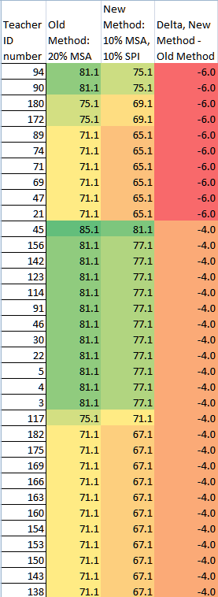
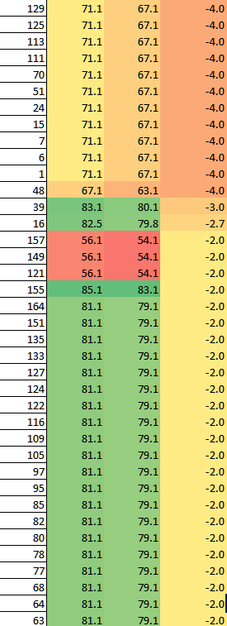
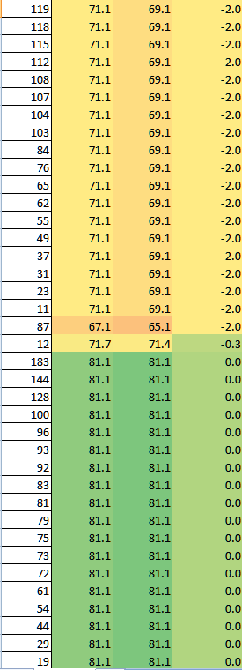
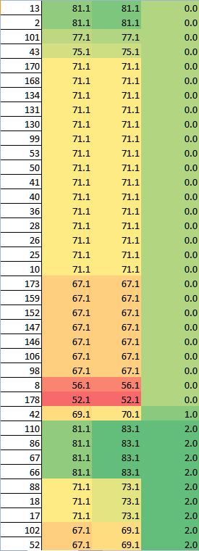
20% MSA/30% SLO v. 10% MSA/10% SPI/30% SLO Top 2 and bottom 2 panels sorted by Delta (n=182 total)

Slide 20
20% MSA & 30% SLO vs.10% MSA/10% SPI & 30% SLO Trial Findings
95% of teacher evaluation scores did not benefit with the inclusion of a 10% SPI measure within the 20% value
Of that 95%...69% actually declined…with the decrement being as much as 3 times the magnitude
SPI lacks the precision to account for weak teachers within strong schools or strong teachers within weak schools
The longitudinal nature of the SPI has attributions that predate the performance of many teachers
The MSA is more closely under the control of the teacher and breaks in their favor, using M-TAI.

Slide 21
Attributing Shared Measures: Grade,Team & Subject Indices

Slide 22
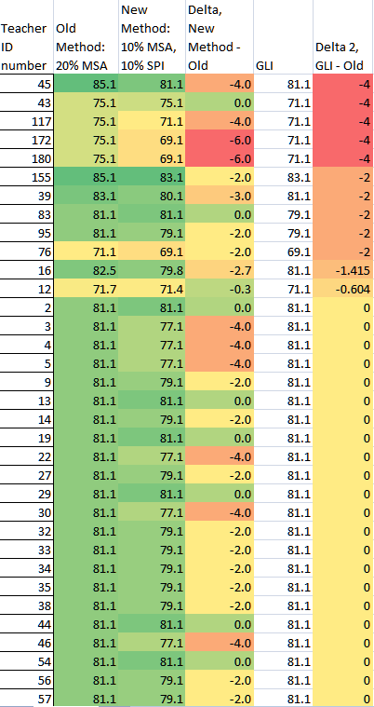
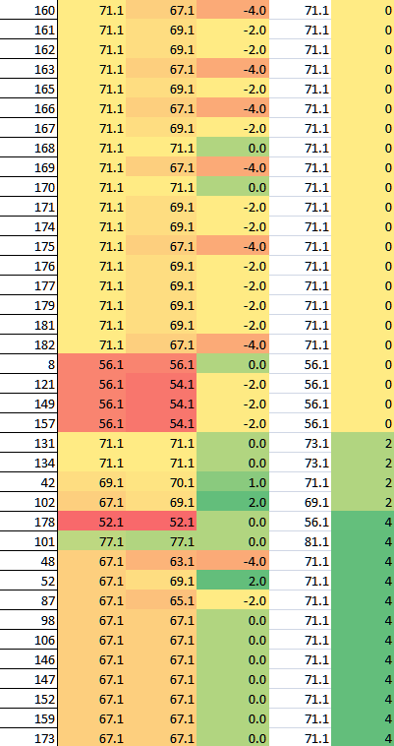
Top and bottom of a GLI distribution, sorted by Delta, showing 20/30 and 10/10 also (n=182 total)

Slide 23
A sample Grade Level Index…. Trial Findings
A GLI tends to dilute the effect of the MSA effects; scores become flattened
85% saw no change in their rating as a result of using a GLI
There was approximately an 8% spread between teachers contributing to the GLI; some lost as much as 4% on their score rating and some gained as much as 4%
The loss was greater among stronger teachers
The gain was greater among weaker teachers
Further study is required to determine whether the 8% spread is consistent across LA GLI tends to dilute the effect of the MSA effects; scores become flattened

Slide 24
Can we make it fair ?
Managing Workload
Attention to Complexities
Teacher/Principal Ownership
Preparation

Slide 25
More Time
Field Test Teacher and Principal Ratings extended to May 17th
State Pilot Field Testing data extended to June 1
Extended LEA submission date to June 7th

Slide 26
Immediate Data MSDE will Require to Close out the Field Test
New Data

Slide 27
Additional Data Requested from Three LEAs Testing the State Model
Teacher ID
School ID
Grade Taught
Four Professional Practice Domains
Summary Professional Practice Score
MSA: R, M, R&M, or N/A
N Attributed Students
M-TAI 2 Raw Score
MSA Points: 20, 16, 12, 10
SLO scores
SPI Score
Total Student Growth Score
Final Rating Score

Slide 28
WestEd Data Analysis
De-identified educator and school ID
Grade and subject assignment
Part of the pilot or not
Number of years teaching in the LEA
Number of attributed students
Professional Practice Domain 1 (planning and preparation) percentage and score
Professional Practice Domain 2 (instructional delivery) percentage and score
Professional Practice Domain 3 (classroom management and environment) percentage and score
Professional Practice Domain 4 (professional responsibility) percentage and score
MSA score
SLO 1 percentage and score
SLO 2 percentage and score
Other SLOs if used
Other local whole school measure if used, percentage and score
Other local growth measure if used, percentage and score
Summary Professional Practice score
Summary Student Growth score
Overall Rating
Prior rating using the established evaluation system for comparison

Slide 29
Pre-Conference
Data Analysis
Translate MSA to %
Set SLOs
Review Annual Data
Align SIP Goals
Write SIP
SIP
HSA Results
AP Results
MSAs
AP
HSAs
MSA
Results
Evaluation
Score SLOs
Score Professional
Practice
Carry forward MSA %
Complete Rating
Affirm Attribution
Set new Professional
Practice Goals
Professional Practice
Conduct Observations
Mid-Interval SLO Check
New Evaluation Paradigm

Slide 30
MSDE Communication Efforts
TPE website MarylandPublicSchools.org/MSDE/programs/tpe
Bi-weekly TPE Communication newsletters
Other MSDE publications
RTTT Monthly Update
Maryland Classroom
Monthly LEA TPE Field Test meetings
TPE Google Group
Use communication resources to facilitate two-way dialogue with LEAs
Notes:
Posted here are the outcomes we want to achieve by the end of this meeting. We will focus with becoming familiar with the SLO components which automatically forces us to talk about the process for writing SLOs.
First, lets talk about… how did we got to this point…
Why are we talking about evaluating teachers in a different way and including a measure of student growth/progress?

Slide 31
Student Learning Objectives Quality Control Components
Ensure Accountability
Provide Guidance, Templates, and Tools
Establish Priority of Standard
Determine and Score Rigorous Targets
Identify High-Quality, Common Measures & Assessments
Monitor and Audit
Provide Professional Development
Develop Two-Way Communication Plan
31
Notes:
31
Graphic represents the essential activities required for quality assurance.
Reach each box and arrow. Emphasize the continuous nature of the PD.
New (in red font) – Two-way communication plan

Slide 32
MSDE Professional Development Efforts
Provided SLO regional trainings (Phase I, II and III) for local school systems (all 24 systems participated in at least one regional training)
Phase 1 – Background, Components, Process
Phase 2 - Quality Assurances: Critical Content, Assessments, Targets and Action Plan
Phase 3 – On-line Training Modules, Implementation Planning
Notes:
Posted here are the outcomes we want to achieve by the end of this meeting. We will focus with becoming familiar with the SLO components which automatically forces us to talk about the process for writing SLOs.
First, lets talk about… how did we got to this point…
Why are we talking about evaluating teachers in a different way and including a measure of student growth/progress?

Slide 33
MSDE Professional Development Efforts
Provided 88 additional SLO presentations to date including:
Superintendents
LEA Content Supervisors
Chief Academic Officers
Executive Officers
Building Administrators
Teachers
MSDE Staff
Notes:
Posted here are the outcomes we want to achieve by the end of this meeting. We will focus with becoming familiar with the SLO components which automatically forces us to talk about the process for writing SLOs.
First, lets talk about… how did we got to this point…
Why are we talking about evaluating teachers in a different way and including a measure of student growth/progress?

Slide 34
MSDE Professional Development Efforts
Maryland Teachers of the Year
Maryland Teachers of Promise
Institutions of Higher Education
Maryland Approved Alternative Teacher Preparation Programs (MAAPP)
On-site training provided in 19 school systems
Notes:
Posted here are the outcomes we want to achieve by the end of this meeting. We will focus with becoming familiar with the SLO components which automatically forces us to talk about the process for writing SLOs.
First, lets talk about… how did we got to this point…
Why are we talking about evaluating teachers in a different way and including a measure of student growth/progress?

Slide 35
MSDE Professional Development Efforts
Presented at State and national conferences
Maryland Assessment Group
Common Ground Conference
National Educator Effectiveness Summit
Reform Support Network
Co-planning the Maryland SLO Conference
June 12, 2013
Notes:
Posted here are the outcomes we want to achieve by the end of this meeting. We will focus with becoming familiar with the SLO components which automatically forces us to talk about the process for writing SLOs.
First, lets talk about… how did we got to this point…
Why are we talking about evaluating teachers in a different way and including a measure of student growth/progress?

Slide 36
SLO Training Modules
Add graphic
Notes:
Our work and interaction with other states has reinforced the importance of quality PD for the successful implementation of SLOs. Knowing that challenge and timeframe of full implementation this fall, we wanted to create a resource to assist you. To that end, we hired Dr. Kim Fleming, to develop a series of on-line training modules.

Slide 37
SLO Modules
7 Training Modules
Module 1 - SLO Context & Purpose
Module 2 - SLO Components
Module 3 - The SLO Process
Module 4 - Quality Assurance: Priority of Standard
Module 5 - Quality Assurance: Rigor of Target
Module 6 - Quality Assurance: Quality of Measure & Evidence
Module 7 - Quality Assurance: SLO Action Plan
Companion Handbook
Notes:
Kim’s Part Begins – Provide big picture overview. MSDE is providing PD resources for districts to use with teachers and principals.
State development training tool available on LMS – Blackboard. In the public domain, as well as behind a registered login.
First 3 modules – Intro and overview
Last 4 modules – 4 areas of quality assurance
Today we will explore two of these modules and discuss ways they could be used to provide PD. Technology questions will be put in a parking lot to be discussed later in the presentation.

Slide 38
TPE Action Team
Dave Volrath
Communication Team
Laura Motel
Field Test Team
Ben Feldman
SLO Team
Linda Burgee
Leadership
Development Team
Ilene Swirnow
Strategic
Delivery of
Professional
Development
Readiness

Slide 39
Local Model Teacher
Evaluation &
Professional
D
evelopment Cycle
____________________
Professional Practice
E
v
Classroom Environment
a
50%
Teacher
l
Instruction
Controlled
Teacher
Elements
80%
u
Practice
a
Planning & Preparation
t
i
Student Learning
o
30%
n
Objectives
MSA/PARCC
20%
Individual
Professional
Tested Area
Development
Teacher
Example
Plan

Slide 40
Translating
MSA to a %
Extracting Teacher
& Principal Measures
Setting SLOs
Writing
the SIP
Data Analysis
Aligning SIP
Goals
Observing
Professional
Practice
Conference
SIP
HSA Results
AP Results
MSAs
AP
HSAs
MSA
Results
Reviewing
Annual Data
Evaluation
Professional Practice
Building the TPE Professional Development Calendar

Slide 41
Strategic Delivery TPE Professional Development
Strategies for Effective Evaluation Practices |  |  |  |  | Strategies for Effective Student Learning Objective Practices
Support Personnel | Audience | Know and be able to do | Venues |  |  | Know and be able to do | Audience | Training Personnel
Ilene Swirnow Dave Volrath | Higher Education Teacher Preparation |  |  |  |  |  | Higher Education Teacher Preparation | Linda Burgee Jean Satterfield Liz Neal
Ilene Swirnow Joe Freed Frank Stetson | MSDE Content Area and Special Educators |  |  |  |  |  | MSDE Content Area and Special Educators | Linda Burgee Susan Oskin Lynne Gilli
Ilene Swirnow Joe Freed Frank Stetson | LEA Content Area and Special Educators |  | . |  |  |  | LEA Content Area and Special Educators | Linda Burgee SLO Team
Ilene Swirnow Joe Freed Frank Stetson | Executive Officers |  | . |  |  |  | Executive Officers | Linda Burgee Joe Freed Frank Stetson
Advisory Committee MASSP MAESP | Principals |  |  |  |  |  | Principals | LEAs Advisory Committee MASSP MAESP
MASSP MAESP | Assistant Principals |  | . |  |  |  | Assistant Principals | LEAs Principals MASSP MAESP
LEAs Principals MSEA | Teachers |  |  |  |  |  | Teachers | LEAs Principals MSEA

Slide 42
Support Personnel | Audience | Know and be able to do | Venues | Know and be able to do | Audience | Training Personnel
Ilene Swirnow Joe Freed Frank Stetson | Executive Officers | Ex. Offs. understanding of Professional Practice and interrelatedness of CCSS Ex. Offs. understanding of Danielson protocols Ex. Offs. understanding of how student growth measures contribute to principal evaluation Ex. Offs. understanding of how to measures MSA/PARCC and contribute it to a principal’s evaluation Ex. Offs. understanding of how to attribute students to principals Ex. Offs. demonstration of skills required to participate in an evaluation pre-conference and end of year conference Ex. Offs. understanding of how to help principals craft personal professional development in response to evaluation | MSDE Executive Officer Mtgs. MSDE Monthly LEA Mtgs. MSDE Ed. Eff. Academies District administrator Mtgs. | Ex. Offs. understanding of how to craft SLOs for teachers and principals Ex. Off. understanding of how to connect Common Core to SLOs Ex. Offs. understanding of how to apply SLOs to evaluation: goals, evidence, & attainment | Executive Officers | Linda Burgee Joe Freed Frank Stetson

Slide 43
Professional Development for 2013-2014
Meeting Frequency
Meeting Location
Attendee/Group Make-up
Common Messaging
Reduced Redundancies
Topical Interests
Delivery Preferences

Slide 44
Will it make a difference in the performance of students, teachers, and principals?
Quality Control
Data & Project Analysis
Professional Development Plans

Slide 45
WestEd:
Deeper data analysis of Field Test experiences
Random state wide educator surveys
Comprehensive TPE project analysis
TPE/MSDE:
Year Four Project Plan
LEA assurance audits
Crafting of the teacher and principal professional development plan process and products in response to evaluation
Longer-term data results

Slide 46
Decision Points
Divergence or convergence ?
Changes going forward

Slide 47
Decision Point 1
The merit of the School Progress Index in teacher evaluation and its maintenance in the Maryland State Teacher Evaluation Model.

Slide 48
Decision Point 2
The standardizing of three Student Learning Objectives in the Maryland State Teacher and Principal Models to include one SLO that is based on the emerging protocols for incorporating HSAs into evaluation.

Slide 49
Decision Point 3
The determination of Effectiveness Ratings for the Maryland State Teacher and Principal Evaluation Models using a standards setting that is based upon results from the three state pilot experiences.

Slide 50
Decision Point 4
The distribution of mini-grants that require decentralized quality control assurances on the part of LEAs should be provided to support local implementation needs.

Slide 51
Decision Point 5
The determination of a method for monitoring and validating local quality controls must be designed.

Slide 52
Decision Point 6
A plan that articulates Teacher and Principal Evaluation with the concurrent initiatives of the Common Core State Standards and the PARCC Assessments must be finalized and communicated.

Slide 53
Decision Point 7
Determinations regarding either approved local models or defaulting to the Maryland State Teacher or Principal Models must be rendered as quickly as possible after the June 7, 2013, submission date.
Notes:
Similar to December 26, 2012
Everyone re-submits*
There will be a processing page
Place to indicate changes
Signature pages
Determinations as quickly as possible

